Slide 1

3 Reasons Your Leadership Sucks!
And how to improve it.
Michael Cardus
CREATE-LEARNING.COM
Teambuildingwny.blogspot.com

Slide 2

How did I get myself into this?
I never thought being a leader would be this tough.

Slide 3
Roles Of The Innovative Leader:
Promote Idea Development
Bring the Right People Together
Define a Viable Mission
Ensure Effective Planning and Implementation
Develop Organizational Absorptive Capacity

Slide 4
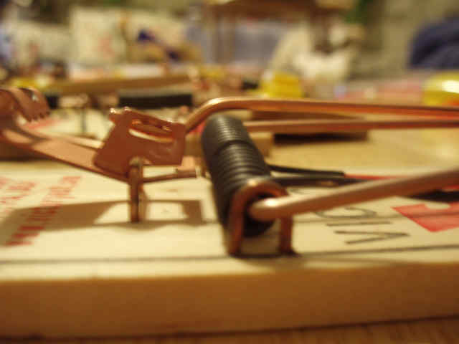

Slide 5
Do I know you?
Just Shut up and do your job.
What you do doesn’t matter.
Remember that project you did last year? Well you really blew it!
YOUR FIRED!

Slide 6
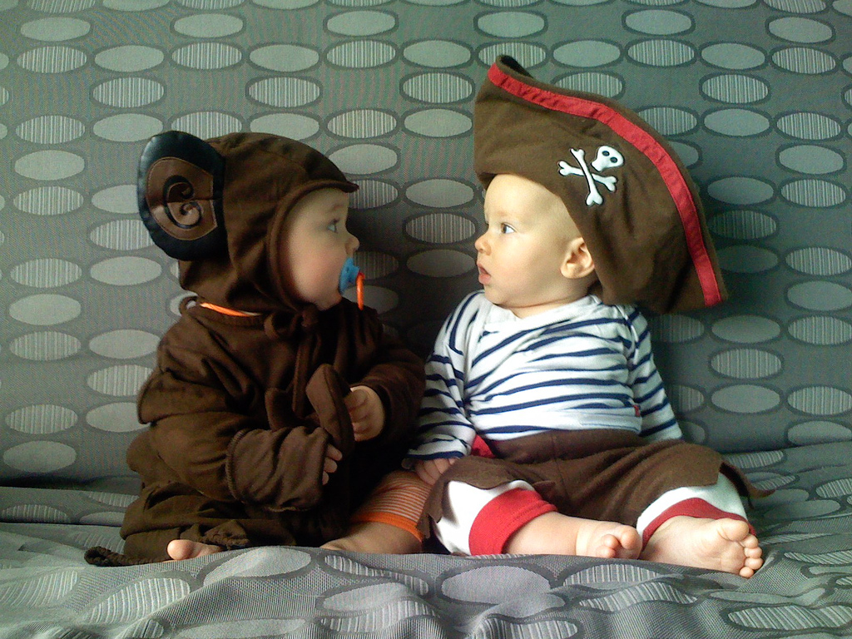
Who are you?
Tell me about yourself?
Leaders must take a genuine interest in their team members

Slide 7
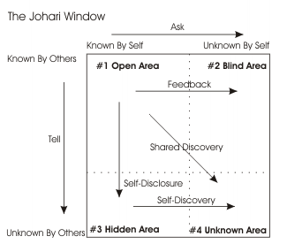

Slide 8
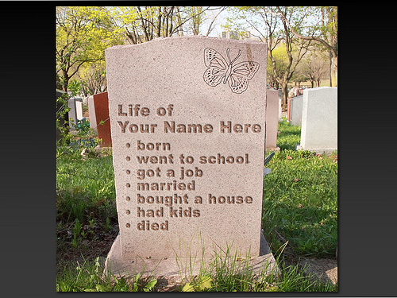
Leaders must illustrate that what team members do in their work lives matters.
All people want to know that their work matters to someone.

Slide 9

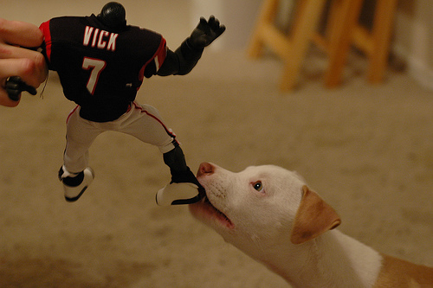
Fear of Becoming Irrelevant
“Human beings need to be needed, and they need to be reminded of this pretty much every day. They need to know they are helping others, not merely serving themselves”
- Patrick Lencioni – The Three Signs of a Miserable Job. Page 232

Slide 10

Who are you helping?
Who’s lives are you impacting?

Slide 11
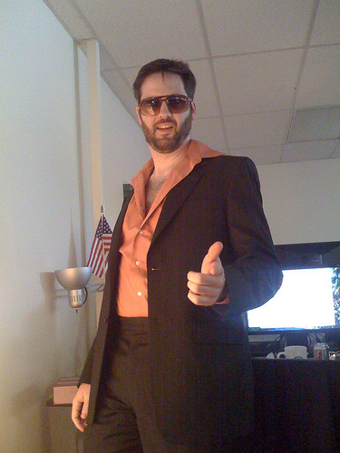
For many people the answer is their BOSS!

Slide 12

How am I helping?

Slide 13
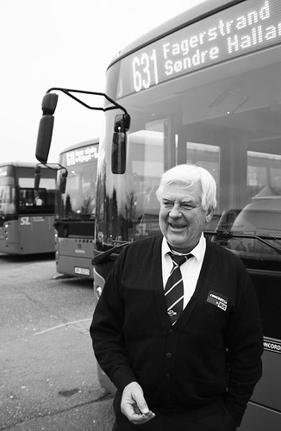
“If managers cannot see beyond what their employees are doing and help them understand how they are making a difference, then those jobs are bound to be miserable.”
-Patrick Lencioni – The Three Signs of a Miserable Job. Page 235

Slide 14
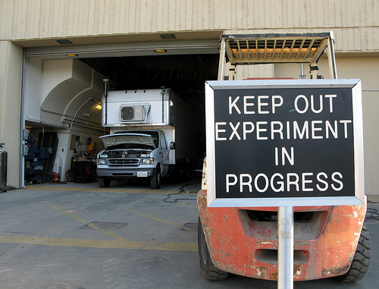
How am I doing?
How do I know that?
What am I being measured against?

Slide 15
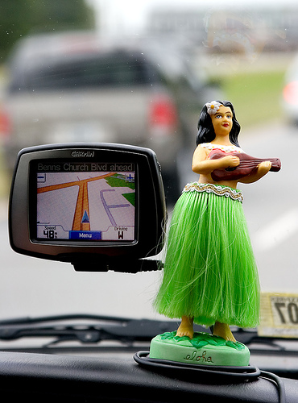
Leaders must work with team members to establish immediately measureable successes and failures. The problem is that employees have no idea of success and failure until 6 months to a year after the work is done.

Slide 16
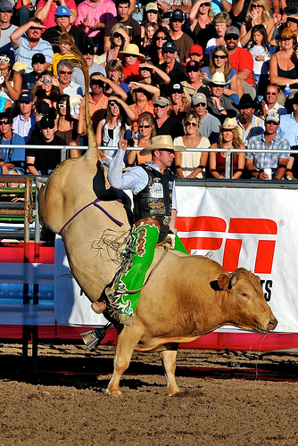
“Employees need to be able gauge their progress and level of contribution themselves. They cannot be fulfilled in their work if their success depends upon the whims of another person, no matter how benevolent that person may be.
Without tangible means of assessing success and failure, motivation eventually deteriorates as people see themselves as unable to control their own fate.”
- Patrick Lencioni – The Three Signs of a Miserable Job. Page 236

Slide 17
Anonymity
Irrelevance
IM-Measurement

Slide 18


1-716-629-3678
CREATE-LEARNING.COM

Slide 19
Photo Credit(s) in order of appearance
Flickr.com
mikecolvin82
Pedrosimoes7
juhansonin
cogdogblog
Viernest
nineball2727
woodleywonderworks
veganstraightedge
magnetbox
Lars Andreas
jurvetson
delriophoto.com
ieshraq

Slide 20

The content of this presentation is based on Patrick Lencioni – The Three Signs of a Miserable Job.
http://www.tablegroup.com/books/signs/

