Slide 1
Risk Assessment & Safety Management (RASM)
Managing Program Safety through Active Leadership
Rick Curtis www.OutdoorEd.com www.IncidentAnalytix.com
Copyright © Rick Curtis 2019
Notes:
Introduction

Slide 2
Creative Commons License
This presentation is made available under the Creative Commons 3.0 License. The information below must be included in all usage/display of this copyrighted work.
You are free:
to Share — to copy, distribute, display, and perform the work
to Remix — to make derivative works
Under the following conditions:
Attribution. You must attribute the work in the manner specified below (but not in any way that suggests that they endorse you or your use of the work).
Noncommercial. You may not use this work or any derivative work for commercial purposes. Individuals or organizations wishing to use this material for commercial purposes may purchase a license.
Share Alike. If you alter, transform, or build upon this work, you may distribute the resulting work only under the same license to this one.
Apart from the remix rights granted under this license, nothing in this license impairs or restricts the author's rights.
Attribution Statement (must be included in all works):
The Risk Assessment & Safety Management Model is the creation of Rick Curtis.
Notes:
This presentation and associated materials is being released under the Creative Commons 3.0 license. This material is copyrighted by Rick Curtis. It may be used under the following conditions. This slide must be shown whenever this presentation is given.
The information below must be included in all usage/display of this copyrighted work.
You are free:
to Share — to copy, distribute, display, and perform the work
to Remix — to make derivative works
Under the following conditions:
Attribution. You must attribute the work in the manner specified by the author or licensor (but not in any way that suggests that they endorse you or your use of the work).
Noncommercial. You may not use this work for commercial purposes.
Share Alike. If you alter, transform, or build upon this work, you may distribute the resulting work only under the same or similar license to this one.
Apart from the remix rights granted under this license, nothing in this license impairs or restricts the author's rights.
Attribution Statement (must be included in all works):
The Risk Assessment & Safety Management Model is the creation of Rick Curtis Director of the Outdoor Action Program at Princeton University and the founder of OutdoorEd.com.

Slide 3
Presenter Preparation
Review the presentation and be comfortable with the concepts. I’ve included detailed presenters notes for each slide to illustrate how I give this presentation.
Make this as interactive as you can. Question your audience. Ask them to brainstorm. The more they come up with the concepts the more they will incorporate them into their own practice.
Have true stories of your own program to illustrate the major points.
I’ve found that the two clips from the movie Cast Away are particularly helpful for illustrating points and for keeping the audience actively engaged and thinking. Details on the clips are included in the slides.

Slide 4
Risk Assessment & Safety Management (RASM)
Managing Program Safety through Active Leadership
Rick Curtis www.OutdoorEd.com www.IncidentAnalytix.com
Copyright © Rick Curtis 2019
Notes:
Introduction

Slide 5
Introduction
Rick Curtis
Pronouns: he, him, his
Director, Princeton University Outdoor Action Program: 38+Years
Author: The Backpacker’s Field Manual
Founder: www.OutdoorEd.com
Founder: www.IncidentAnalytix.com

Slide 6
Workshop Design
The purpose of this presentation is to prepare you to teach this same workshop to your staff. The workshop content typically takes 1-2 hours.
Storytelling is an important part of this training and teaching through telling your staff about real incidents is essential. Presenting this workshop with your own stories will increase the length.
With these stated goals I won’t do a deep dive into the RASM Model at the Program Administration level. There is a detailed article on that at www.OutdoorEd.com that provides that level of material (search for RASM).

Slide 7
Workshop Design
During most of the workshop I’ll present as if I am teaching it to one of my groups. When I need to step out of presenter mode to give you some background instructions or insight I’ll say “off stage” and when I go back into presenting I’ll say “presenting”

Slide 8
Risk Assessment & Safety Management (RASM)
Managing Program Safety through Active Leadership
Rick Curtis www.OutdoorEd.com www.IncidentAnalytix.com
Copyright © Rick Curtis 2019
Notes:
Introduction

Slide 9
Risk Management is not just…

Slide 10
Learning Objectives
Provide you with a complete training module for your staff
Identify the principal causal factors in accidents/near misses
Explore a model for managing risk that incorporates the principal causal factors
Identify methods for assessing and managing risk before an event
Identify methods for evaluating risk and mitigating it in the field
Notes:
The objectives of this presentation are to:
Provide you with a complete training module for your staff
Identify the major causal factors in accidents/near misses
Explore a model for managing risk that incorporates the major causal factors
Identify methods for assessing and managing risk before an event
Identify methods for evaluating risk and mitigating it in the field

Slide 11
What is an Incident?
Event with some negative outcome
Close Call/Near Miss
Notes:
Ask the audience to define an Incident. Bring up the difference between an Incident and a Close Call/Near Miss.

Slide 12
Types of Incidents
Injury
Illness
Motivational/Behavioral
Psychological
Bias
Crime
Harassment
Inappropriate/Criminal Sexual Contact
Property Damage

Slide 13
Defining Risk/Reward
-R: Negative R (Risk) is the potential for loss, injury, illness
+R: Positive R (Reward) is the potential for gain, growth, development
Notes:
In this model there are two different types of risk the first is what I call Negative R(isk) or Negative R. Negative R is the potential for loss injury or illness which is what we typically associate with accidents in the field. Positive R(isk) or Positive R is the potential for gain growth and development. So in all of our programs, we have both Negative R and Positive R.
We all know about the negative model of risk, what is the positive side of risk in our industry? Risk is an underlying principal in all of outdoor and adventure education. The fundamental philosophical principles of Kurt Hahn and others is that the exposure to risk/challenge is what impels people to personal growth.
Each program has to evaluate the level of Negative R that is appropriate for your organization's mission. For example, in my work running wilderness orientation programs for incoming college freshmen, the level of Negative R that is appropriate to accomplish our mission is low. However, if I am working in a therapeutic program with serious drug offenders, the consequences for them not getting off drugs have huge Negative R so I would tolerate running a program that might have a higher Negative R in order to influence behavior change.

Slide 14
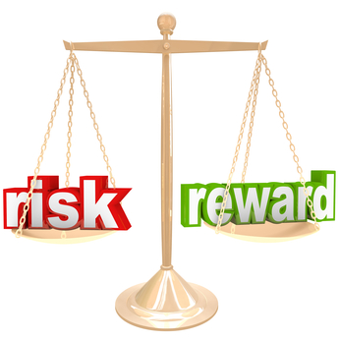
Balancing Risk/Reward

Slide 15
Risk is…
Inherent: -R exists in our activities
Expected: -R can occur at any time
Integral: -R and +R are essential parts of our programs
Determine the appropriate level of –R for your program
Notes:
So risk is inherent in our programs. That is Negative R exists in all adventure activities. Risk is expected. Negative R can occur at any time so we have to expect the unexpected. Risk is manufactured. We plan programs with the understanding that there is some Negative R. In fact our programs wouldn't function without some level of Negative R. And finally risk is integral. Both Negative R and Positive R are essential parts of our programs.

Slide 16
How do we Manage Risk?
The Risk Assessment & Safety Management Model (RASM) takes into account the negative causation factors (Hazards) of other models
It also adds in positive Safety Factors which interact dynamically with the Hazard Factors to alter the Risk Level
Managing risk can be achieved by both reducing Hazard Factors and/or adding Safety Factors
Notes:
The Risk Assessment and Safety Management model (RASM) takes into account the negative causation factors or hazards of previous models but it also adds in positive safety factors which interact dynamically with a hazard factors to alter the risk level. That means that managing risk can be accomplished by both reducing hazard factors and also by adding safety factors in the equation, something the earlier models didn’t focus on.

Slide 17
The Accident Iceberg
Serious or Major Injury: Includes disabling and serious injuries
1
Minor Injury: Any reported injury less than serious
10
Property Damage: All types
30
600
Incidents With No Visible Injury or Damage: Near misses or close calls
Accident Ratio Study (Bird & Germaine, 1989)
Notes:
Some of you may be familiar with what is called the Accident Iceberg or the Accident Pyramid. What do we know about in Iceberg – that 90% is actually underwater and most of it can’t be seen. That’s the metaphor for how accidents with serious negative consequences relate to all other accidents.
This is based on the work of Bird and Germain studying accidents in industrial settings. It has been replicated in 2003 by Conoco Philips and is generalized here for the outdoor industry.
Their research showed that for every serious or major injury there would be 10 minor injuries, 30 cases of property damage and 600 close calls. Based on this model what is the most predictive data point for the Risk Level of a particular activity – the 600 Near Misses.
Give an example: I give an example of lighting backpacking stoves. In the history of our program with tens of thousands of stoves lit over 45+ years, how many times do you think a stove has flared up and burned someone in the face? Answer – One. How many times do you think stoves have flared up and people have jumped out of the way? Answer - Thousands. Si what data point is most predictive about the hazards of lighting backpacking stoves? Answer - the Close Calls. If we only looked at the One incident, we would say stoves are very safe and we don’t really need to worry about them. KEY POINT: Recording and Tracking Close Calls is critical to your risk management process. They are far more predictive pf your risk level.
Get people to think about how many times people have a near miss and never pay attention to it, never learn from it. In fact, near missed can desensitize you to the actual Risk Level since you didn’t actually have a negative outcome.

Slide 18
Risk Level
Risk Levels are levels of increasing risk and therefore increased potential for a negative outcome.
Risk Level is assigned to an ascending scale of 1 to 5 (arbitrary).
The interaction of Hazard Factors and Safety Factors creates the Risk Level.
There is no such thing as an overall Risk Level of Zero.
Notes:
Risk Levels are levels of increasing risk and therefore increased potential for accidents.
Risk Level is assigned to an ascending scale of 1 to 5 (arbitrary).
The interaction of Hazard Factors and Safety Factors creates the Risk Level.
There is no such thing as a Risk Level of Zero. – in any activity the overall risk level cannot be zero

Slide 19
Risk Formula
Probability * Severity = Risk Level
Notes:
The formula for determining the level of Risk is
RISK = PROBABILITY OF OCCURENCE * SEVERITY OF OUTCOME

Slide 20
Risk Formula
How Likely? * How Bad? = Risk Level
Notes:
The formula for determining the level of Risk is
RISK = PROBABILITY OF OCCURENCE * SEVERITY OF OUTCOME

Slide 21
Risk Level Matrix
Probability | High
 | Medium
 | Low
 |  | Low | Medium | High
 | Severity of Consequences
Notes:
If we map out Probability and Severity on a Matrix we get the following grid. When things are in the GREEN zone we are generally at an acceptable level of Risk. As things move into the YELLOW zone we need to start thinking about how my might need to intervene to reduce the Risk Level. When things get into the RED zone we need to take immediate active steps to reduce the risk level. In the next slide we’ll look at how we can actually apply some numbers to these level.

Slide 22
Risk Level Calculator
Notes:
At this slide open the Excel file Risk Level Calculator and demonstrate the interaction between Low, Moderate and High Probability and Low, Moderate and High Severity. For this scaling example we will use:
LOW – Values of 1, 2, 3
MODERATE – Values of 4, 5, 6
HIGH – Values of 7, 8, 9

Slide 23
Assess your Risk Level
Red Light
Yellow Light
Green Light
Stop
Caution
Go
Notes:
If we do

Slide 24
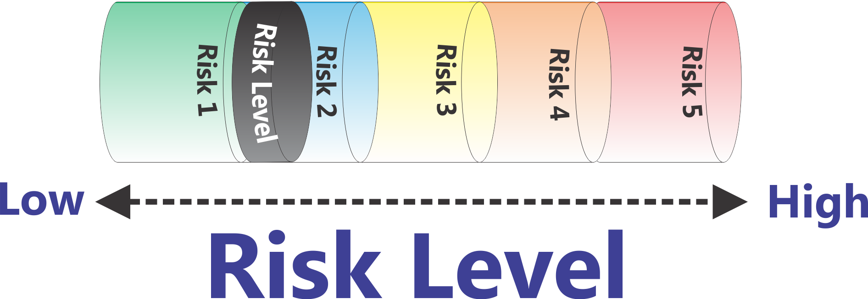
‘Flattened’ Matrix
Low
High
Risk Level
Notes:
Here is a representation of increasing Risk Levels. As the Risk goes up (Probability * Severity) then the piston goes up.
In this particular demonstration of the RASM model we are arbitrarily setting the risk level with a scale of one to five. What risk scale you actually use is up to you. This five point scale is based on the U.S. Department of Homeland Security Threat (Risk) Advisory level. (Low - Green, Guarded - Blue, Elevated - Yellow, High – Orange, Severe – Red)
Can the risk level ever be zero? No, there is no such thing as a risk level of zero. Whenever we send out a trip or run a program there is some level of risk. The question is to determine at an organizational level what level of risk you are comfortable operating your program at.

Slide 25
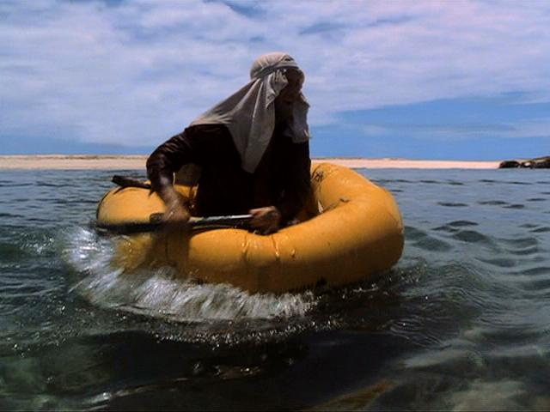
An Accident in the making…
Cast Away Scene 1
DVD Chapter 14
Notes:
Now let’s look at an accident happen in Real Time. How many people have seen the movie Cast Away with Tom Hanks? Give short intro of movie plot an introduce this scene – DVD Chapter 14 “A Light in the Distance”

Slide 26
What were the Causal Factors?
Notes:
Ask audience to come up with causal factors. Write them on a whiteboard placing them into Equipment, Environment, People categories (without labeling the categories) and then ask the audience to come up with the categories. Now they have built the first part of the RASM model.

Slide 27
Hazard Factors
Equipment
Environment
People
No Food Water
Fear / Anxiety
Paddle
Huge Waves
Indecisive
Raft
Coral Reef
No Plan
Notes:
Go through each of the “Hazard Balls” for the Cast Away example.
Let's take a look at a working model of this that will show how these factors all interact to create a dynamic risk level.

Slide 28
Risk Assessment & Safety Management Model (RASM) ©
Environment
People
Equipment
Low
High
Risk Level
Notes:
So let's take a look at the overall risk assessment and safety management model in the following graphic. What you see here can be thought of as a simple balance scale. If we look on the left side we see a series of hazard factors that fall into three categories: Environmental Hazards, Equipment Hazards, and People Hazards (aka Human Factor Hazards) . In the center we see risk levels. As Hazard Factors accumulate on the left-hand side of balance scale, here shown as adding balls into the cylinders, the piston in the Risk Level cylinder moves to the right. Increasing the risk level doesn’t mean that you are going to have an accident, just that the potential for having an accident is increasing.
In the case of Tom Hanks and Cast Away scene if I land 1 foot to the left of the coral reef and am uninjured, what is the Risk Level? Answer – it is the same. This is a Close Call not an Accident but the Risk Level for having the accident occur is the same.
This is a place to remind people of the Risk Formula:
Probability * Severity = Risk Level

Slide 29
Hazard Factors
Environment
High Water
High Temperatures
Lightning
Equipment
Improper gear
Broken equipment
People
Medical Conditions
Fatigue
Poor Communication
Fear/Anxiety
Notes:
The actual “balls” that you put into the model are going to be dependent on the types of activities you are doing, your location, etc. Here are some examples of factors (balls) in the Environment, Equipment, and People Hazard categories. You might choose to enter different examples based on your particular context.
If you want to get more detailed about this you can have the group brainstorm examples of the different categories of Hazard Factors. You can also break the People Factors into different populations (people hazards for everyone in the group, people hazards for participants, people hazards for leaders, and people hazards for the entire group). There are some slides of this in the appendix.

Slide 30
How “Big” are Hazards
We can think of Hazards as Balls which have a certain size and weight. The greater the ‘mass’ the greater the potential impact.
If a particular Hazard might have multiple impacts/negative consequences, then the total possible impact of that Hazard is adding the scores (Probability of A) * (Severity of A) + (Probability of B) * (Severity of B)
Example: High Altitude can lead to Pulmonary Edema and to Cerebral Edema. Each one would have it’s own Probability and Severity

Slide 31
Hazard Impact
Analyzing the actual Hazard is essential in determining the extent to which it is a large or small factor.
Potential Consequences of High Temperature
Dehydration
Heat Exhaustion
Heat Stroke
Air Tempe-rature
Notes:
‘Not All Hazards are the Same Size’ – Have the same impact
Calculating the impact of risk is more than just identifying the particular hazard. It’s also important to recognize that some hazards have more impact than others. One formula that is used for calculating the individual risk is
RISK = PROBABILITY OF OCCURENCE * SEVERITY OF OUTCOME
Let’s take the example of Heat Illness. There are a number of illnesses associated with High Temperatures.
Dehydration
Heat Exhaustion
Heat Stroke
At the end of the PowerPoint there is a different example using High Altitude. You can build your own by identifying a particular Hazard Ball that could have multiple consequences (mild, moderate, severe) and then demonstrate a mild impact and a severe impact.

Slide 32
Hazard Impact = ‘Ball Size’
80° F/ 27° C
Dehydration Probability Low * Severity Low = Low Risk (2) - GREEN
Heat Exhaustion Probability Low * Severity Moderate = Low Risk (5) - GREEN
Heat Stroke Probability Low * Severity High = Low Risk (9) - YELLOW
Air Temper-ature
Risk Level = 15
Notes:
Let’s see what the impact of this particular Hazard Factor will be at 80 degrees F (27 C). For this example the actual numbers are not based on any real scale (or the 1-5 scale) but merely serve to illustrate the point.
At 80 degrees F the chance of Dehydration is moderate but the severity at this temperature is low so we’ll give it a total value of
Probability Low (2) * Severity Low (1) = Low Risk (2) - GREEN
Heat Exhaustion is Probability Low (1) * Severity Moderate (5) = Low Risk (5) - GREEN
Heat Stroke is Probability Low (1) * Severity High (9) = Low Risk (9) - YELLOW
Although the risk is generally low overall, it is going up as we move from Dehydration to Heat Exhaustion to Heat Stroke as you would expect.

Slide 33
Hazard Impact = ‘Ball Size’
100° F/ 38° C
Dehydration Probability Moderate * Severity Moderate = Moderate Risk (16) - YELLOW
Heat Exhaustion Probability Moderate * Severity High = Moderate Risk (35) - YELLOW
Heat Stroke Probability Moderate * Severity High = High Risk (45) - RED
Air Temper-ature
Risk Level = 96
Notes:
Let’s see what the impact of this particular Hazard Factor will be at 100 degrees F (38 C). For this example the actual numbers are not based on any real scale (or the 1-5 scale) but merely serve to illustrate the point.
At 100 degrees F the chance of Dehydration is moderate but the severity at this temperature is low so we’ll give it a total value of
Probability Moderate (4) * Severity Moderate (4) = Moderate Risk (16) - GREEN
Heat Exhaustion is Probability Moderate (5) * Severity High (7) = Moderate Risk (35) - YELLOW
Heat Stroke is Probability Moderate (5) * Severity High (9) = High Risk (45)

Slide 34
Hazard Factors - 80° F/ 27° C
Air Tempe-rature (15)
Environment
People
Equipment
Low
High
Risk Level
Notes:
At 80 degrees F (27 C) Air Temperature is not a really big Hazard Ball.

Slide 35
Hazard Factors – 100° F/ 38° C
Air Tempe-rature (96)
Environment
People
Equipment
Low
High
Risk Level
Notes:
At 100 degrees F (38 C) Air Temperature is really big Hazard Ball.

Slide 36
Hazard Factors
Equipment
Environment
People
No Food Water
Fear / Anxiety
Helmet
Humidity
Inexperien-ced
Uniform
Air Temp
Dehyd-rated
Notes:
Now that we have a sense of the impact of air temperature as a hazard ball let’s look at all the other hazards that could be part of this hot day of athletic training:
EQUIPMENT
Heavy Uniform with pads
Helmet limiting cooling
What if there isn’t adequate food or water available
ENVIRONMENT
Besides the air temperature, what about the relative humidity? If it is really high, then sweating is less effective for evaporative cooling.
PEOPLE/HUMAN FACTOR
What is the person arrives at practice already dehydrated?
Imagine that this person is a new student playing their first day with the team.
What if the person feels uncomfortable speaking up that they are tired/hot (don’t want to disappoint the team/coach on the first day).?

Slide 37
Managing the Risk Level
So How Do You Reduce the Risk Level?
Remove all the Hazards you can
What if that’s not Enough?
Add Safety Factors
Notes:
So how to you Manage the Risk Level:
Remove all the Hazards you can
Add Safety Factors

Slide 38
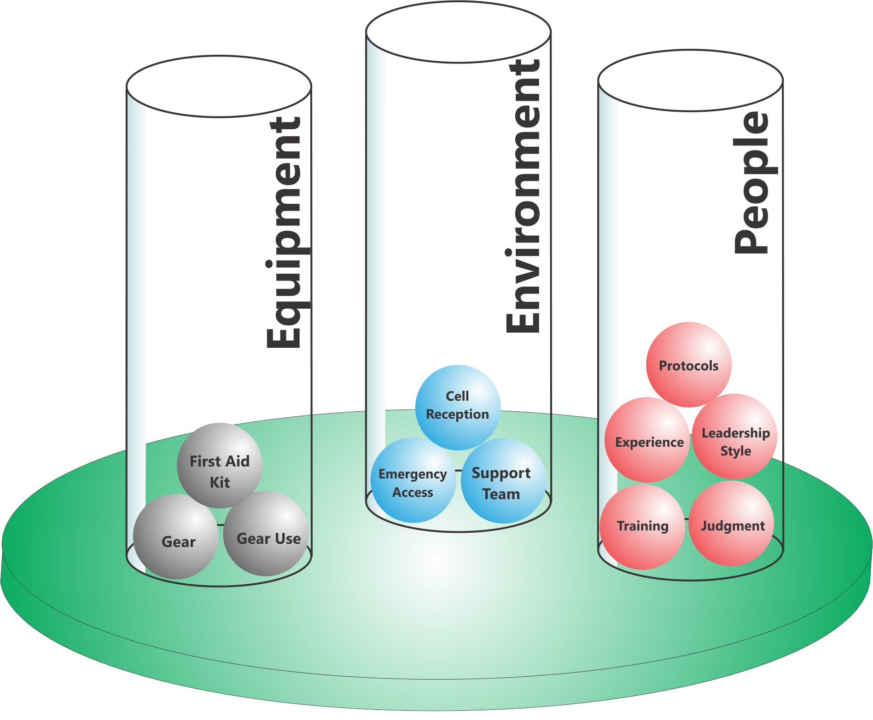
Add Safety Factors
People
Environment
Equipment
Notes:
We can look at adding Safety Factors in the same three areas
Equipment
Environment
People
Going back to our High Altitude Example, what can we do to reduce the risk at 18,000 feet?
Can we eliminate the Hazard Factors (Balls) that are creating the risk? No
What are our other options? Add a Safety Factor
So here is what we did

Slide 39
Risk Assessment & Safety Management Model (RASM) ©
Environment
People
Equipment
Low
High
Risk Level
Notes:
Now we are seeing the other side of the RASM model.
On the right side we now see another part of the balance scale−the Safety Factors−in three categories as before: Environmental Safety Factors, Equipment Safety Factors, and People Safety Factors. When we add “balls” into the Safety Factors we make the risk level go down. Of course it will never go to zero, but we can reduce the risks by adding Safety Factors in.

Slide 40
Safety Factors also have “Weight”
Big Safety Factors have a greater impact on the Risk Level than Small Safety Factors

Slide 41
Risk Assessment & Safety Management Model (RASM) ©
Environment
Environment
People
People
Equipment
Equipment
Low
High
Risk Level
Notes:
So now we are back at the overview of the model and I think you have a good sense of the dynamic interaction that this model provides.
Now let’s put it all together. The Hazard Factors operate to push the Risk Level up while the Safety Factors operate to pull the risk level down. For simplicities sake on the illustrations, all the balls are shown as the same size. As we’ve shown some may be much larger than others and ‘weigh more’ having a much greater or lesser influence on the ultimate Risk Level. For example having a hurricane hit your trip is a massive hazard factor made up of a series of conditions (high winds, downed trees, flooding, temperature, etc.)

Slide 42
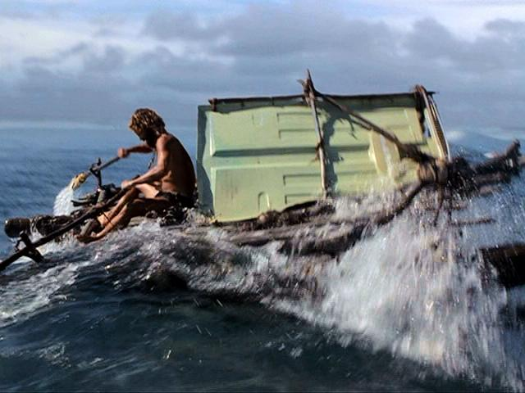
An Accident in the Making - 2
Cast Away Scene 2
DVD Chapter 23
Notes:
Give a summary of what has transpired in the movie up to this point – He survives for 1500 days. He decides to try and get off the island to get back to his wife (high reward) which is balanced appropriately with the high risk.
Ask your group - Observe what happens this time and note:
What is the same from his previous attempt?
What is different from his previous attempt?
MAKE A NOTE THAT THE WIND CHANGES DIRECTION – This becomes important because he doesn’t actually launch the raft until the wind is blowing out to sea. He needs the wind to push his sail.

Slide 43
Hazard Factors
Equipment
Environment
People
No Food Water
Fear / Anxiety
Paddle
Huge Waves
Indecisive
Raft
Coral Reef
No Plan
Notes:
Explain how he has reduced the Hazard Factors

Slide 44
Safety Factors
Equipment
Environment
People
Sail
Determined
Food Water
Decisive
Paddles
Wind
Plan
Raft
Notes:
Explain how he has increased Safety Factors.
Is his Risk Level 0 – No, but for him, in this situation, it is an Acceptable Level of Risk
Acceptable Risk has to be defined by each program and each individual activity like the R- R+ we discussed before

Slide 45
Risk Assessment & Safety Management Model (RASM) ©
Environment
Environment
People
People
Equipment
Equipment
Low
High
Risk Level
Notes:
So now we are back at the overview of the model and I think you have a good sense of the dynamic interaction that this model provides.
Now let’s put it all together. The Hazard Factors operate to push the Risk Level up while the Safety Factors operate to pull the risk level down. For simplicities sake on the illustrations, all the balls are shown as the same size. As we’ve shown some may be much larger than others and ‘weigh more’ having a much greater or lesser influence on the ultimate Risk Level. For example having a hurricane hit your trip is a massive hazard factor made up of a series of conditions (high winds, downed trees, flooding, temperature, etc.)

Slide 46
Safety Factors – for 100° F/ 38° C
Equipment
Environment
People
Notes:
Given our example of Air Temperature, have your group brainstorm what are some Safety Factors they could add in to reduce the Risk Level?
EQUIPMENT
ENVIRONMENT
PEOPLE

Slide 47
Some Hazards can’t be removed
First Aid Training
People
Allergic Person
People
Benadryl
Equipment
Bees
Environment
Equipment
Epi- nephrine
Hazard Factors
Safety Factors
Low
High
Risk Level
Notes:
I like to reinforce the idea that some hazards can’t be removed and that only by adding Safety Factors in can you reduce the Risk Level. In this example having an environment with bees on the trail and having someone on the trip who is allergic to bees are the things increasing the Risk Level. You can’t remove these things so all you can do is to add Safety Factors on the other side of the equation. Those don’t do anything to remove the Probability. Instead they reduce the potential Severity of the situation if the person gets stung.
Note: Some programs may not carry medications like Benadryl and Epinephrine or allow their staff to use such things. In that case you should come up with your own example that illustrates this point. Or you can refer people back to the Tom Hanks scenario where the waves and the coral reef were still there.

Slide 48
If the Risk Level is still too High?
Know when to ‘bail out’
If the Risk Level is too high, what is your expectation of your leaders and their expectation?
Notes:
Ask the class what happens when the Risk Level is high and you cannot bring it down to an acceptable level by reducing Hazard Factors or adding Safety Factors. The answer is to bail out. I give a detailed example from my program where leaders have made a good decision by bailing out. They looked at the situation and determined that there was no way to continue without a significant level of risk.
When you can’t bring the risk down, look at ‘changing the game.’

Slide 49
7 Steps in RASM
Identify Hazard Factors
Assess Risk Level
Remove Hazard Factors
Assess Risk Level
Add Safety Factors
Assess Risk Level
Bail Out

Slide 50
Risk Assessment & Safety Management Model (RASM) ©
Environment
Environment
People
People
Equipment
Equipment
Low
High
Risk Level
Notes:
So now we are back at the overview of the model and I think you have a good sense of the dynamic interaction that this model provides.
Now let’s put it all together. The Hazard Factors operate to push the Risk Level up while the Safety Factors operate to pull the risk level down. For simplicities sake on the illustrations, all the balls are shown as the same size. As we’ve shown some may be much larger than others and ‘weigh more’ having a much greater or lesser influence on the ultimate Risk Level. For example having a hurricane hit your trip is a massive hazard factor made up of a series of conditions (high winds, downed trees, flooding, temperature, etc.)

Slide 51
Transferring this to Campus
Seeing someone who has had too much to drink
Observing someone trying to hook up with someone who is unable to consent
If you see something going wrong and you don’t speak up, what are you?
A Human Factor Hazard Ball!
Being a Leader takes Courage – entering your Brave Space

Slide 52
Diversity & Inclusion Risks
Physical Safety is only one dimension on the Risk Management spectrum
Emotional Safety is equally important and Hazards can be equally life threatening
Teens committing suicide after bullying
LGBTQ individuals being harassed
Talk to your staff about where there are Emotional/Interpersonal Hazards, Assess the Risk Level, and establish the necessary guidelines, structures, protocols, culture to manage the risk

Slide 53
Hazing
College Men’s Swimming & Diving Season Cancelled
How did this happen? Let’s work backwards:
What kind of environment existed to allow this behavior?
What was the culture on the team? How long had it been present?
Presuming that the coaching staff did not know, what does it say about the level of communication/trust?
Why didn’t any of the team members tell coaches?

Slide 54
Hazing
What Safety Balls need to be put in place to prevent this from happening again?
How do we productively build a cohesive team spirit that doesn’t involve tearing down ‘the other’?
Full Value Contract
Bystander Intervention Training
Healthy ‘high challenge’ & healthy activities for team bonding
Cross team study sessions (match players by courses)
Swift discipline by coaching staff

Slide 55
Discussion
What is the “typical” Risk Level our program operates at? How much variation is there?
Do our Safety Factors outweigh our Hazard Factors?
How often do we shift into a higher Risk Level on a program?
Are we set up to allow protocols to change as we shift into different Risk Levels?
What do we need to do to implement this system in our organization?
Notes:
These are some important discussion questions to have the group discuss.

Slide 56
Small Group Discussion…
Look at one example of physical risk in your setting and analyze the Hazard Factors, Risk Level and potential Safety Factors
Look at one example of emotional risk in your setting and analyze the Hazard Factors, Risk Level and potential Safety Factors

Slide 57
Implementation: Program Level
Look at each activity you do and assess…
Hazard Factors in each of these categories…
Environment
Equipment
People
Safety Factors in each of these categories…
Environment
Equipment
People
What Risk Level(s) you are comfortable operating with and are appropriate for your program goals?
Notes:
This slide explores how to implement the RASM model in your program. For each activity (backpacking, rock climbing, etc.) you should
Assess the Hazard Factors
Environmental Hazard Factors
Equipment Hazard Factors
People Hazard Factors
Assess your Safety Factors to deal with the potential hazards
Environmental Safety Factors
Equipment Safety Factors
People Safety Factors
Decide if the Risk Level is acceptable
Based on your assessment you need to decide if this activity can be done at an acceptable risk level given your program’s resources.

Slide 58
Implementation: Staff Level
Pre-trip
Assess the Hazard Factors
Environmental Hazard Factors
Equipment Hazard Factors
People Hazard Factors
Prepare an Hazard Briefing for participants
Assess your Safety Factors to deal with the potential hazards
Environmental Safety Factors
Equipment Safety Factors
People Safety Factors
Decide if the Risk Level is acceptable
Notes:
Once you are doing an activity before a trip goes out you need to have field staff run through this same process.
Assess/Review the Hazard Factors
Environmental Hazard Factors
Equipment Hazard Factors
People Hazard Factors
Prepare an Hazard Briefing for participants
What do they need to know to keep themselves safe
Assess/Review your Safety Factors to deal with the potential hazards
Environmental Safety Factors
Equipment Safety Factors
People Safety Factors

Slide 59
Implementation: Staff Level
During the Trip
Teach the RASM Model to Participants
Assess
Environmental Hazards
People Hazards
Equipment
Increasing Risk Level/Accident Potential
“Treat” all the Hazards you can
Add additional Safety Factors if necessary/possible
Reassess Risk Level
If it’s still too high, change things
Notes:
During the trip leaders should use the RASM model to regularly assess the situation for Hazard Factors and for increasing Risk Levels. Using a standard medical model you should “treat” (remove) all the Hazard Factors you can and “treat” (add) all the Safety Factors you can and then reassess the situation.
I remind people of the Patient Assessment System (PAS) taught in many first aid courses. This is a model that they probably know already and RASM mirrors this approach. Giving them another tool that syncs with logical frameworks they already use helps them remember.

Slide 60
Implementation: Post Program
After the Trip
Turn in Incident/Near Miss Reports
Review events with staff
Assess need for program changes: protocols, training, resources, etc.
Notes:
Gathering data for both accidents and close calls is essential to get the full picture of potential risk. Remind people about the Accident Iceberg and any examples you gave there.
Using whatever your program’s format is people should turn in both accident reports and close call reports. This is a time to reinforce with leaders how critical this is to overall risk management.
Note: People interested in tools for collecting and managing incident data should refer to the International Incident Database Project (www.incidentdatabase.org)

Slide 61
Analyzing an Accident
Reviewing existing accidents or near misses in your program using the model is a useful technique to assess your program
Analyze an Accident in small groups:
Call out some accidents/close calls you have seen in your program or others:
Aquatics
Climbing Wall
Field Sport (Rugby)
Heat
Ice Hockey

Slide 62
Implementing RASM
Look at each activity you do and assess…
Hazard Factors in each of these categories…
Environment
Equipment
People
Safety Factors in each of these categories…
Environment
Equipment
People
What Risk Level(s) you are comfortable operating with and are appropriate for your program goals?
Notes:
This slide explores how to implement the RASM model in your program. For each activity (backpacking, rock climbing, etc.) you should
Assess the Hazard Factors
Environmental Hazard Factors
Equipment Hazard Factors
People Hazard Factors
Assess your Safety Factors to deal with the potential hazards
Environmental Safety Factors
Equipment Safety Factors
People Safety Factors
Decide if the Risk Level is acceptable
Based on your assessment you need to decide if this activity can be done at an acceptable risk level given your program’s resources.

Slide 63
Take Home Action Steps
For each program activity brainstorm a list of Hazard Factors in each of the three major categories (Environment, Equipment, People)
For each program activity brainstorm a list of Safety Factors in each of the three major categories (Environment, Equipment, People) designed to mitigate against Hazard Factors

Slide 64
Take Home Action Steps
Balance the Hazard Factors against the Safety Factors and determine the range of Risk Levels you will be operating in. Based on your program, decide whether the Risk Level is acceptable or not.
If the Risk Level is not acceptable, assess how to modify Hazard Factors and Safety Factors to reduce the Risk Level.
Have your students think about how this model applies to their lives back on campus – for example seeing someone who is severely intoxicated
Notes:
If you see something, say something. This is Bystander Intervention back on campus. If you see something that is a potential hazardous situation and you don’t intervene, what are you? You are a Hazard Ball (People Hazard). I remind my students that others know that they are outdoor program leaders and know first aid and CPR. If they see you not reacting, they may assume that it’s not a hazardous situation. Leadership is about stepping up even when it’s difficult.

Slide 65
Final Thoughts
Final Thoughts
The biggest mistake
about a mistake
is not learning from it

Slide 66
Resources
www.OutdoorEd.com
Search for NIRSA or RASM
Copyright © 2019 Rick Curtis, Outdoor Ed LLC. All rights reserved.

Slide 67
Resources
www.IncidentAnalytix.com
Cloud-based Software for Incident & Close Call Tracking and Real Time Data Analytics
Copyright © 2019 Rick Curtis, Outdoor Ed LLC. All rights reserved.

Slide 68
APPENDICES
These are some additional resources that you can use when you teach the RASM approach and include some case studies for the class to analyze in small groups

Slide 69
Spinning Class Scenario
Rhabdomyolysis
Freebie Rhabdomyolysis: A Public Health Concern. Spin Class-Induced Rhabdomyolysis
https://www.amjmed.com/article/S0002-9343(16)31206-2/fulltext
Risk factors for the development of rhabdomyolysis are related to the intensity of the exercise, the conditioning of the participant, hydration, and body temperature, in addition to other potential contributing factors. Physiology studies have demonstrated that significant numbers of calories are burned,⁵ fluid losses are significant,⁶ and body temperatures increase⁷ during spinning classes.
1 Freebie Rhabdomyolysis: A Public Health Concern. Spin Class-Induced Rhabdomyolysis, Brogan, Maureen et al. The American Journal of Medicine , Volume 130 , Issue 4 , 484 - 487

Slide 70
Hazard Factors
Equipment
Environment
People
Lack of Water
Hot Room
Dark Space
Loud Music
Large Class Size
Inexperienced Participant
‘Go for it’ attitude
Poor physical shape
Post exams
Inexperienced Instructor
Notes:
Explain how he has reduced the Hazard Factors

Slide 71
Is this a Preventable Accident?
Clinical Significance¹
Spinning is an intense exercise.
Spinning can put newcomers at risk for exertional rhabdomyolysis.
Guidelines for the public need to be established that include safe ways to start spinning.
There needs to be public awareness of signs and symptoms of rhabdomyolysis so that early treatment can be obtained.
1 Freebie Rhabdomyolysis: A Public Health Concern. Spin Class-Induced Rhabdomyolysis, Brogan, Maureen et al. The American Journal of Medicine , Volume 130 , Issue 4 , 484 - 487

Slide 72
Backpacking Trip Scenario
Sally is leading a group of ninth graders on the school’s annual 4-day wilderness trip. This is Sally’s fourth such trip. Dan the other teacher from the school is new this year and doesn’t have any backpacking experience. But it’s hard to find teachers at the school who are willing to go. Dan is young and a good athlete and seems to be learning quickly. It’s early September in the Shenandoahs and the group of 8 students and two teachers has started their second day of hiking. The temperature has soared up to the nineties with humidity around 80%. The group slept in and cooked pancakes so they got a late start on the trail. After a 2 mile hike, the group stops for lunch. Sally notices large cumulus clouds starting to build over the ridge. It’s already after one o’clock and eager to get on to camp, they finish lunch and head off for a long descent down Little Devil’s Staircase, a ledgy section of rock trail along a dry stream gorge.

Slide 73
Backpacking Trip Scenario
The upper section is dry and the rock is slick and polished. As the afternoon progresses, the group is moving more slowly down the gorge. The smaller students are having trouble handling the steep sections and slick rocks with their packs. More than once Dan has had to take a student’s pack as well as his own over the difficult sections. The clouds have now become thick thunderheads and the sky is darkening. They still haven’t reached the bottom trail. The wind is picking up and large raindrops are spattering here and there on the rocks. Suddenly the sky opens up and the rain is falling in torrents. Dan, while carrying a student’s pack, slips on the wet polished rock and falls backwards striking his head sharply against a boulder. The student next to Dan screams. Sally is at the front, picking her way down the trail when she hears the scream. She drops her pack and scrambles up to Dan who is unresponsive when she first arrives. She quickly checks for breathing and pulse and then Dan starts to open his eyes.

Slide 74
Backpacking Trip Scenario
Analyze Hazard Factors
Environmental Hazards
People Hazards
Equipment Hazards
Recommend Safety Factors
Environmental Hazards
People Hazards
Equipment Hazards

Slide 75
Backpacking Trip Analysis
Environmental Hazards
Rocky trail
Wet trail
Rain
Lightning
Heat
Humidity
Dehydration
People Hazards
Age of participants - their physical abilities and experience
Dan’s inexperience
Limited group resources in an emergency
Equipment Hazards
Too much weight in packs

Slide 76
Backpacking Trip Analysis
Reducing the Risk Level
Environmental Safety
The trip route should include an understand of how weather conditions can increase the Risk Level of a particular section.
The group should have a plan for "bail out" in case of bad weather.
People Safety
More experienced leaders.
The group can have a better plan for the day in terms of mileage, when to leave camp, rest breaks, lunch breaks, etc.
The leaders should have better knowledge of the appropriateness of the route to the age group/experience of the participants.
Have more group resources in the event an emergency (other adult chaperones)
Have a protocol for dealing with storms
Equipment Safety
Better packs for the size of the kids
Less weight

Slide 77
Ice Hockey Traumatic Accident - 2008
NOTE this is a gruesome accident so preview first and decide if this is appropriate for your audience.
https://www.youtube.com/watch?v=k9VoI9O-Vb4
https://www.youtube.com/watch?v=dR-wA4SmbO4
https://www.youtube.com/watch?v=Yh_UN3RuoN8&has_verified=1
https://www.youtube.com/watch?v=dT4PenDwiPo
Notes:
If you need another example,

Slide 78
Clint Malarchuk – March 22, 1989

Slide 79
Hazard Impact
Analyzing the actual Hazard is essential in determining the extent to which it is a large or small factor.
Potential Consequences of High Altitude
Mild Altitude Sickness
High Altitude Pulmonary Edema (HAPE)
High Altitude Cerebral Edema (HACE)
High Altitude
Notes:
‘Not All Hazards are the Same Size’ – Have the same impact
Calculating the impact of risk is more than just identifying the particular hazard. It’s also important to recognize that some hazards have more impact than others. One formula that is used for calculating the individual risk is
RISK = PROBABILITY OF OCCURENCE * SEVERITY OF OUTCOME
Let’s take the example of High Altitude. There are a number of illnesses associated with High Altitude.
Mild Altitude Sickness
High Altitude Pulmonary Edema (HAPE)
High Altitude Cerebral Edema (HACE)

Slide 80
Hazard Impact = ‘Ball Size’
10,000 feet/3,048 meters
Mild Altitude Sickness Probability Moderate * Severity Low = Low Risk (5*1 = 5) - GREEN
High Altitude Pulmonary Edema (HAPE) Probability Low * Severity High = Moderate Risk (1*9 = 9) - YELLOW
High Altitude Cerebral Edema (HACE) Probability Low * Severity High = Moderate Risk (1* 9 = 9) - YELLOW
High Altitude
Overall Risk Level = 23 (5 + 9 + 9)
Notes:
Let’s see what the impact of this particular Hazard Factor will be at 10,000 feet (3,048 meters).
At 10,000 feet the Probability of Mild Altitude Sickness is moderate but the Severity at this altitude is low so we’ll give it a total value of
Probability Moderate (5) * Severity Low (1) = Low Risk (5) - GREEN
High Altitude Pulmonary Edema (HAPE) is Probability Low (1) * Severity High (9) = Low Risk (9) - YELLOW
High Altitude Cerebral Edema (HACE) is Probability Low (1) * Severity High (9) = Low Risk (9) - YELLOW

Slide 81
Hazard Impact = ‘Ball Size’
18,000 feet/5,486 meters
Mild Altitude Sickness Probability High * Severity Low = Moderate Risk (9*1 = 9) - YELLOW
High Altitude Pulmonary Edema (HAPE) Probability Moderate * Severity High = High Risk (5*8 = 40) - RED
High Altitude Cerebral Edema (HACE) Probability Moderate * Severity High = High Risk (5*9 = 45) - RED
High Altitude
Overall Risk Level = 93 (9 + 40 + 45)
Notes:
At high altitudes the Probability of these illnesses is fairly high and the Severity is high. If we assign some numbers to these we get a Risk Level of 12, a very large ‘ball.’
At 18,000 feet the occurrence of
Mild Altitude Sickness is
Probability High (9) * Severity Low (1) = Moderate Risk (9) - YELLOW
High Altitude Pulmonary Edema (HAPE) is
Probability Moderate (5) * Severity High (8) = High Risk (40) - RED
High Altitude Cerebral Edema (HACE) is
Probability Moderate (5) * Severity High (9) = Low Risk (45) - RED

Slide 82
Hazard Factors - 10,000 ft
High Altitude (23)
Environment
People
Equipment
Low
Risk Level
High
Notes:
So let's take a look at the overall risk assessment and safety management model in the following graphic. What you see here can be thought of as a simple balance scale. If we look on the left side we see a series of hazard factors that fall into three categories: Environmental Hazards, Equipment Hazards, and People Hazards. In the center we see risk levels. As Hazard Factors accumulate on the left-hand side of balance scale, here shown as adding balls into the cylinders, the piston in the Risk Level cylinder will go up. Increasing the risk level doesn’t mean that you are going to have an accident, just that the potential for having an accident is increasing.
This is a place to remind people of the Risk Formula:
Probability * Severity = Risk Level

Slide 83
Hazard Factors – 18,000 ft
High Altitude (93)
Environment
People
Equipment
Low
Risk Level
High
Notes:
So let's take a look at the overall risk assessment and safety management model in the following graphic. What you see here can be thought of as a simple balance scale. If we look on the left side we see a series of hazard factors that fall into three categories: Environmental Hazards, Equipment Hazards, and People Hazards. In the center we see risk levels. As Hazard Factors accumulate on the left-hand side of balance scale, here shown as adding balls into the cylinders, the piston in the Risk Level cylinder will go up. Increasing the risk level doesn’t mean that you are going to have an accident, just that the potential for having an accident is increasing.
This is a place to remind people of the Risk Formula:
Probability * Severity = Risk Level

Slide 84
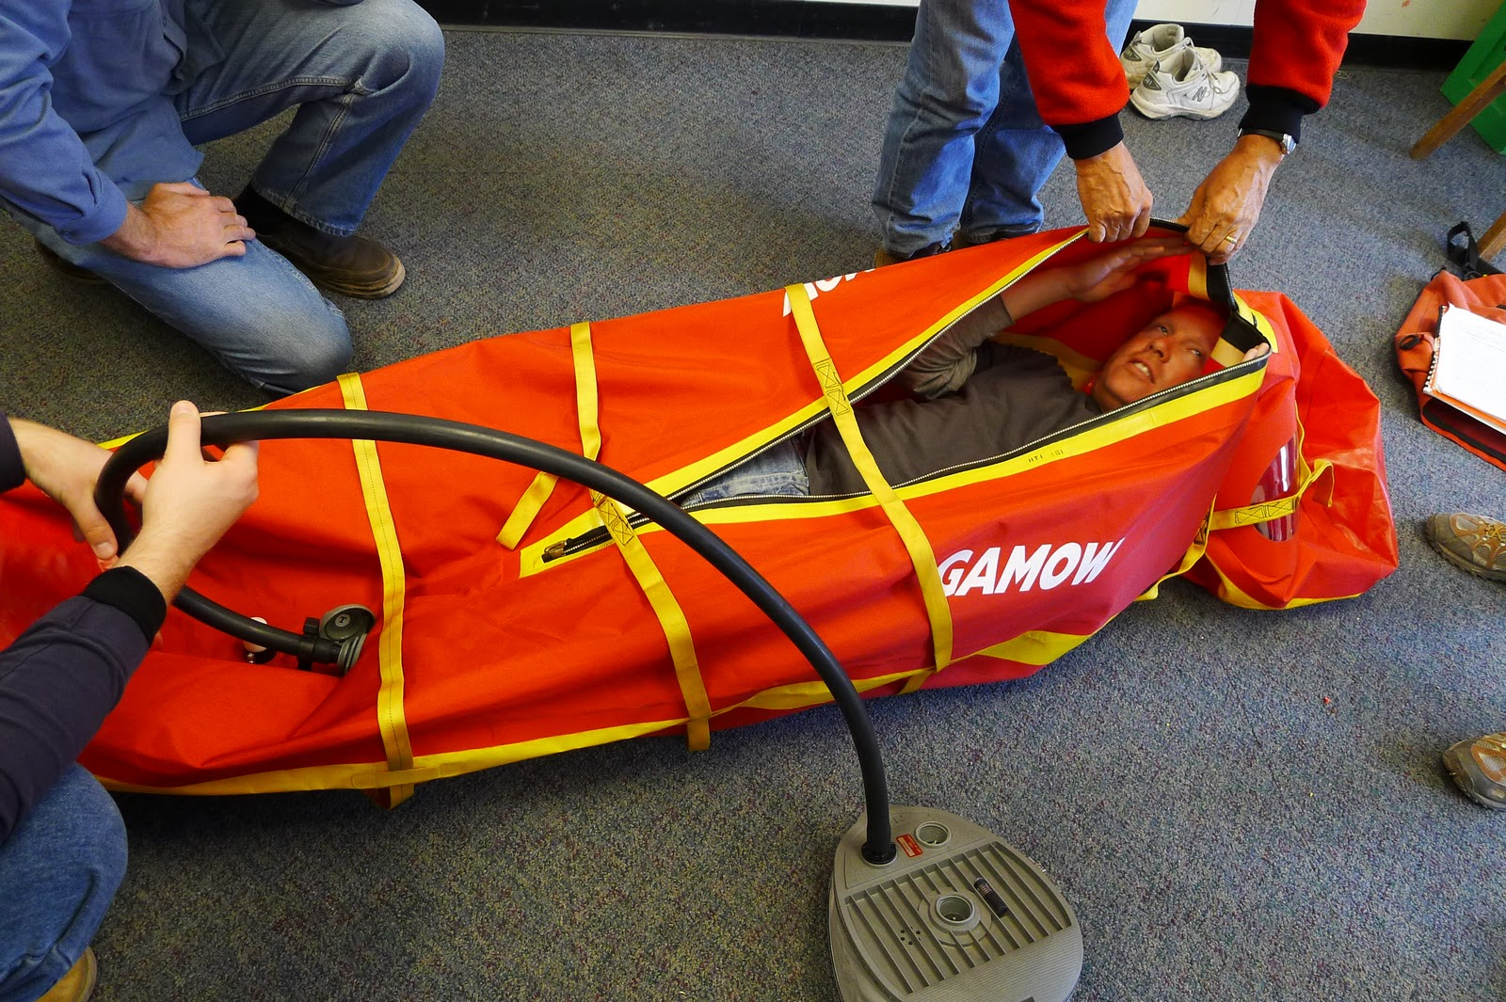
Gamow Bag
Notes:
There is no way to remove the Altitude Hazard (except to bail out and don’t go). So the only option to reduce the Risk Level is to bring a Safety Ball. In this case a Gamow Bag. Explain what a Gamow bag does.
https://en.wikipedia.org/wiki/Portable_hyperbaric_bag

Slide 85
Safety Impact
Just as with Hazards the same Safety Factor can have a greater or lesser impact depending on the situation.
River Rescue Training is designed to respond to:
Boat Pinning against Rock
Foot Entrapment
River Rescue
Notes:
‘Not All Balls are the Same Size’
Just like Hazard Balls the impact of Safety Balls is different in different situations. Here is an example of a Safety Ball—River Rescue Training. It can be used to help deal with a boat being pinned against a rock and to deal with foot entrapment—a potentially life threatening situation (river rescue training is for a lot more but we’ll keep it simple for this presentation).

Slide 86
Safety Impact = ‘Ball Size’
Class 1 Flatwater River
Boat Pinning Frequency Low * Severity = Low Risk (1)
Foot Entrapment Frequency Low * Severity High = Low Risk (5)
River Rescue
Safety Impact = 1
Notes:
Let’s imagine we are paddling on a small river with very little current. The chances for a canoe to get pinned by the current are quite low and similarly the chance for a foot entrapment are low. Therefore these ‘hazard balls’ are quite small. As a result the need for river rescue training is greatly reduced. In this case the impact the Safety Ball would have is actually small. Once again these numbers are arbitrary and exist just to illustrate the point.

Slide 87
Safety Impact = ‘Ball Size’
Class 3 Whitewater River
Boat Pinning Frequency Moderate * Severity Moderate = Moderate Risk (5)
Foot Entrapment Frequency Low * Severity High = High Risk (20)
River Rescue
Safety Impact = 25
Notes:
On a Class III Whitewater river the risks of boat pinning or foot entrapment increase significantly. So River Rescue Training is a much more significant Safety Factor in reducing the Risk Level. What this means is that it is important to understand the impact a particular Safety Factor will have and determine which will get you the most ‘bang for the buck.’

Slide 88
Changing Protocols to Manage Risk
Whitewater Class | Protocols/Actions
Class 1 | Base Level: Everyone is wearing a life jacket. Leaders have basic equipment, river knowledge, check river conditions
Class 2 | + Lead & sweep boats or buddy system, Basic river rescue equipment
Class 3 | + Scouting from boats, River rescue training
Class 4 | + Scouting from shore, Safety boats
Class 5 | + Screening of paddlers, Safety Lines set up
Class 6 | + Decision-making plan for running rapid
Notes:
[Note: I consciously use numbers rather than Roman numerals since that might confuse people who don’t know the standard river rating system]
Let's take a look at a real world example. Many people are familiar with the rating system for the difficulty of whitewater rapids. It starts at Class 1 which is basic moving flat water goes to Class 2 which is minor rapids requiring some maneuvering, up to Class 3 more difficult rapids and all the way up to Class 6 which is considered risk of life for a team of experts. In this table we can equate the whitewater class level with an arbitrary risk scale in this case one to six. When paddling on a Class 1 river there are some basic safety factors that are in place: a basic paddling knowledge of the river and checking river conditions, teaching paddling skills, everyone wearing a PFD, etc. These are things that we do in any situation when we are on the water.
When we go to a Class 2 the section of river we add additional safety protocols. We are still using all of the protocols that we established for Class 1 and in addition, for example, we might have lead and sweep boats or use the buddy system, and have basic river rescue equipment and training like a throw bag. In the Class 1 situation these safety factors might not be considered necessary. So it's not the case that we suddenly add every possible safety factor into the equation at the very beginning. We evaluate the risk levels and hazards and add safety factors in as we feel they're needed. That’s where leader judgment comes in (we hinted at this earlier).
So now let's take a look at Class 3 whitewater. In this situation on top of the other protocols that we already are using we add some additional ones. We may scout each rapid from the boats before running them. Instructors are required to have river rescue training.
Another thing we can do is to set a program protocol that says we don’t do anything harder than Class 3 whitewater. That helps keep the level of risk from continuing to go up. It doesn’t mean there is no risk at Class 3, quite the contrary, but the risk level is certainly less than in Class 4.
In addition to this in Class 4 we stop and scout each rapid from shore. We may set the safety boat somewhere along the rapid in case anyone flips. For Class 5 rapids we actively screen the paddlers who are going, we may scout everything from shore, and we may set throw lines along the most difficult sections of the rapid or those with the most serious consequences if there is a swim. Finally, in a Class 6 situation in addition to everything else that we've been doing before we also have an established decision-making plan, agreed upon by all group members ahead of time, about how to decide whether the group and individuals are to run a particular drop.
So this is a great example of how changing risk levels relate to changing safety levels. You can see that the whole system is dynamic: we have hazard factors changing risk levels, and safety factors changing risk levels.

Slide 89
Environmental Hazards
Environment
Rocky trail
Exposed ledges
Cold temperatures
Rain
Darkness
Overexposure to sun
Poison ivy
Bees
Notes:
These some additional examples of Environmental Hazards.

Slide 90
Environmental Hazards
Crossing & Hiking Along Roads
Fast Traffic
Poor Visibility
No Shoulder
Driving
Bad road conditions
Darkness
Unfamiliar road
Difficult road (CLASS 1 - 6)
Notes:
These some additional examples of Environmental Hazards. Driving is the most dangerous activities that groups engage in. Roads are also dangerous since they bring cars into close contact with people (ex. Road crossings). In like to remind people that driving is a lot like whitewater kayaking. Not all roads are the same to drive, some are much more hazardous than others. To import the Whitewater River Classification as a metaphor, a long straight road, with good visibility, a shoulder on a dry day might be considered a Class 1 road in terms of general risk level. A windy mountain road in wet or snowy conditions, with decreased visibility or at night could be a Class 5 driving situation. Just like you wouldn’t put someone who is only a Class 2 kayaker in a Class 5 rapid you shouldn’t put a Class 2 driver into a Class 5 driving situation. This factor often gets ignored because people treat driving as a ‘universal skill.’ It’s not.

Slide 91
Equipment Hazards
Broken stove
Boots not broken in
Improper clothing
Inoperative equipment
Improper food
Notes:
These some additional examples of Equipment Hazards.

Slide 92
People Hazards
Everyone
Medical Conditions
Physical Condition
Fatigue
Notes:
These some additional examples of People Hazards that apply to everyone.

Slide 93
People Hazards
Participants
No awareness of hazards
No skills to avoid hazards
Won’t follow instructions
Irresponsible/careless attitude towards self, others, equipment
Poor physical strength, stamina
Need to "prove" self, macho attitude
Fear/anxiety
Notes:
These some additional examples of People Hazards that apply to participants.

Slide 94
People Hazards
Leaders
Lack of knowledge of environmental hazards
Inadequate skills to extricate group and self from hazards
Poor safety judgment
Poor teaching skills
Instructions unclear
Poor supervisor, does not correct problems
Ineffectual under stress
Notes:
These some additional examples of People Hazards that apply to leaders.

Slide 95
People Hazards
Group
group not yet formed, lacks cooperative structure
interpersonal frictions unresolved
poor communication
excessive competition
lack of concern for slow or different individuals
excessive pressure or stress to “perform”macho
no practice in working harmoniously under stress
splintering into sub-groups
Notes:
These some additional examples of People Hazards that apply to the entire group.

Slide 96
RASM Analysis
Activity ____________
Location ___________
Season ____________
Hazard Factors |  |  | Risk Level | Safety Factors
Equipment | Environment | People |  | Equipment | Environment | People
Notes:
This slide shows a sample form that can be used by staff to assess potential risk before going on a trip and looking to see what Hazard Factors may be present and what Safety Factors may be implemented.
I ask if anyone has ever been hiking in the desert. If so I ask if anyone knows what you do in the morning before putting your boots on. Shake them out to make sure there are no scorpions inside. We don’t operate in the southwest so this is something that our leaders don’t need to know about. But going to a new area, activity, location, etc. means researching that area and understanding the potential hazards and knowing how you may have to respond.
You can brainstorm or discuss other examples. (I also use summer afternoon thunderstorms in the Rocky Mountains and the need to plan a route to be down off high ridges and summits early. Other examples are glacier climbing early in the day before the sun melts things and rock fall increases.)

Slide 97
Hazard Factors
Equipment
Environment
People
Notes:
SAMPLE GRAPHIC TO BUILD YOUR OWN EXAMPLE

Slide 98
Safety Factors
Equipment
Environment
People
Notes:
SAMPLE GRAPHIC TO BUILD YOUR OWN EXAMPLE

