Slide 1
Risk Assessment & Safety Management (RASM)
Manage Program Safety through Active Leadership
Rick Curtis www.OutdoorEd.com www.IncidentAnalytix.com
Copyright © Rick Curtis 2019
Notes:
Introduction

Slide 2
Introduction
Rick Curtis
Pronouns: he, him, his
Director, Princeton University Outdoor Action Program: 38 Years
Oldest University Climbing Wall - 1983
Author: The Backpacker’s Field Manual
Founder: www.OutdoorEd.com
Founder: www.IncidentAnalytix.com

Slide 3
Learning Objectives
Provide you with a complete training module for your staff
Identify the major causal factors in accidents/near misses
Explore a model for managing risk that incorporates the major causal factors
Identify methods for assessing and managing risk before an event
Identify methods for evaluating risk and mitigating it in the field
Notes:
The objectives of this presentation are to:
Provide you with a complete training module for your staff
Identify the major causal factors in accidents/near misses
Explore a model for managing risk that incorporates the major causal factors
Identify methods for assessing and managing risk before an event
Identify methods for evaluating risk and mitigating it in the field

Slide 4
What is an Incident?
Event with some negative outcome
Close Call/Near Miss
Notes:
Ask the audience to define an Incident. Bring up the difference between an Incident and a Close Call/Near Miss.

Slide 5
Types of Incidents
Injury
Illness
Motivational/Behavioral
Behavioral
Bias
Crime
Harassment
Sexual Contact
Property Damage

Slide 6
Who/What is at Risk?
Who? = People
Clients
Adults
Minors
Parents
Employees
Setters
Coaches
Office Staff
Owners/Shareholders
What? = Your Business

Slide 7
Defining Risk/Reward
-R: Negative R (Risk) is the potential for loss, injury, illness
+R: Positive R (Reward) is the potential for gain, growth, development
Notes:
In this model there are two different types of risk the first is what I call Negative R(isk) or Negative R. Negative R is the potential for loss injury or illness which is what we typically associate with accidents in the field. Positive R(isk) or Positive R is the potential for gain growth and development. So in all of our programs, we have both Negative R and Positive R.
We all know about the negative model of risk, what is the positive side of risk in our industry? Risk is an underlying principal in all of outdoor and adventure education. The fundamental philosophical principles of Kurt Hahn and others is that the exposure to risk/challenge is what impels people to personal growth.
Each program has to evaluate the level of Negative R that is appropriate for your organization's mission. For example, in my work running wilderness orientation programs for incoming college freshmen, the level of Negative R that is appropriate to accomplish our mission is low. However, if I am working in a therapeutic program with serious drug offenders, the consequences for them not getting off drugs have huge Negative R so I would tolerate running a program that might have a higher Negative R in order to influence behavior change.

Slide 8
Balancing Risk/Reward

Slide 9
Risk is…
Inherent: -R exists in outdoor adventure activities
Expected: -R can occur at any time
Integral: -R and +R are essential parts of our program
Determine the appropriate level of –R for your program
Notes:
So risk is inherent in our programs. That is Negative R exists in all adventure activities. Risk is expected. Negative R can occur at any time so we have to expect the unexpected. Risk is manufactured. We plan programs with the understanding that there is some Negative R. In fact our programs wouldn't function without some level of Negative R. And finally risk is integral. Both Negative R and Positive R are essential parts of our programs.

Slide 10
How do we Manage Risk?
The Risk Assessment & Safety Management Model (RASM) takes into account the negative causation factors (Hazards) of other models
It also adds in positive Safety Factors which interact dynamically with the Hazard Factors to alter the Risk Level
Managing risk can be achieved by both reducing Hazard Factors and/or adding Safety Factors
Notes:
The Risk Assessment and Safety Management model (RASM) takes into account the negative causation factors or hazards of previous models but it also adds in positive safety factors which interact dynamically with a hazard factors to alter the risk level. That means that managing risk can be accomplished by both reducing hazard factors and also by adding safety factors in the equation, something the earlier models didn’t focus on.

Slide 11
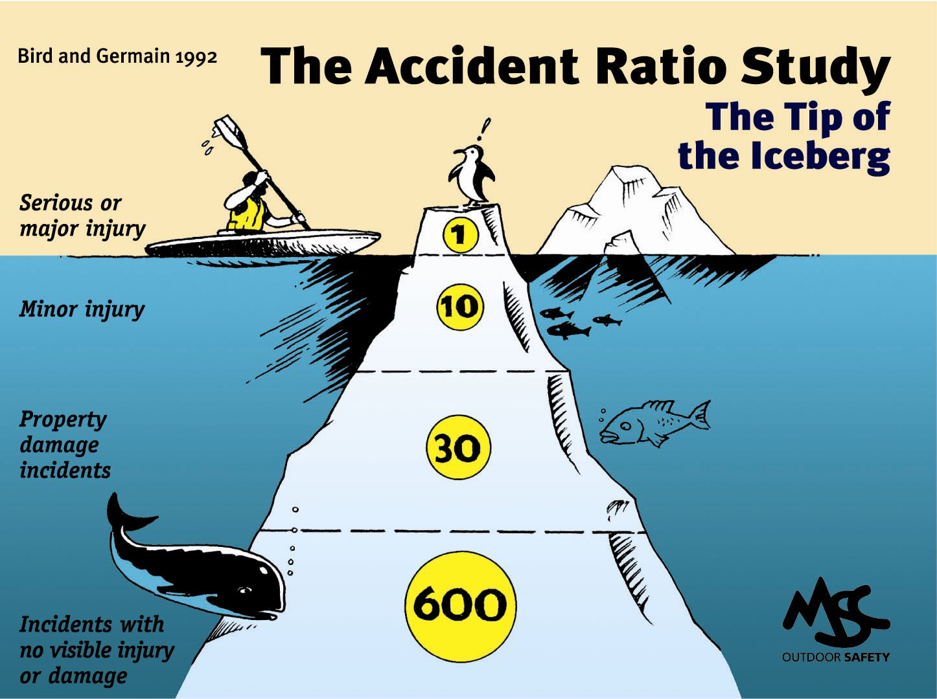
The Accident Iceberg
Notes:
Some of you may be familiar with what is called the Accident Iceberg or the Accident Pyramid. What do we know about in Iceberg – that 90% is actually underwater and can’t be seen. This is based on the work of Bird and Germain studying accidents in industrial settings. It has been replicated in 2003 by Conoco Philips and is generalized here for the outdoor industry.
Their research showed that for every serious or major injury there would be 10 minor injuries, 30 cases of property damage and 600 close calls. Based on this model what is the most predictive data point for the Risk Level of a particular activity – the near misses.

Slide 12
Risk Level
Risk Levels are levels of increasing risk and therefore increased potential for accidents.
Risk Level is assigned to an ascending scale of 1 to 5 (arbitrary).
The interaction of Hazard Factors and Safety Factors creates the Risk Level.
There is no such thing as an overall Risk Level of Zero.
Notes:
Risk Levels are levels of increasing risk and therefore increased potential for accidents.
Risk Level is assigned to an ascending scale of 1 to 5 (arbitrary).
The interaction of Hazard Factors and Safety Factors creates the Risk Level.
There is no such thing as a Risk Level of Zero. – in any activity the overall risk level cannot be zero

Slide 13
Risk Formula
Probability * Severity = Risk Level
Notes:
The formula for determining the level of Risk is
RISK = PROBABILITY OF OCCURENCE * SEVERITY OF OUTCOME

Slide 14
Risk Formula
How Likely? * How Bad? = Risk Level
Notes:
The formula for determining the level of Risk is
RISK = PROBABILITY OF OCCURENCE * SEVERITY OF OUTCOME

Slide 15
Risk Calculator

Slide 16
Risk Level Matrix
Probability | High
 | Medium
 | Low
 |  | Low | Medium | High
 | Severity of Consequences

Slide 17
Assess your Risk Level
Red Light
Yellow Light
Green Light
Stop
Caution
Go
Notes:
If we do

Slide 18
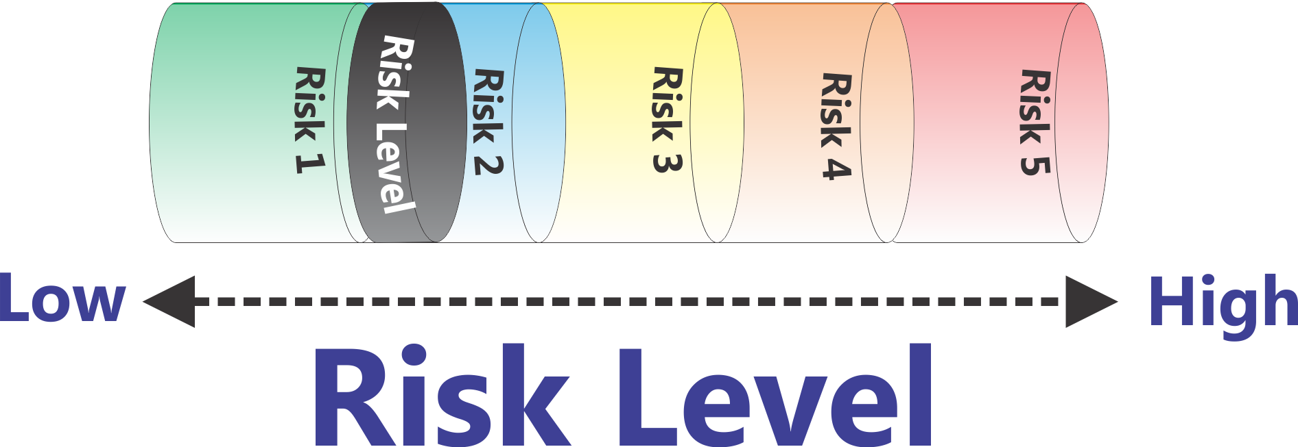
‘Flattened’ Matrix
Low
High
Risk Level
Notes:
Here is a representation of increasing Risk Levels. As the Risk goes up (Probability * Severity) then the piston goes up.
In this particular demonstration of the RASM model we are arbitrarily setting the risk level with a scale of one to five. What risk scale you actually use is up to you. This five point scale is based on the U.S. Department of Homeland Security Threat (Risk) Advisory level. (Low - Green, Guarded - Blue, Elevated - Yellow, High – Orange, Severe – Red)
Can the risk level ever be zero? No, there is no such thing as a risk level of zero. Whenever we send out a trip or run a program there is some level of risk. The question is to determine at an organizational level what level of risk you are comfortable operating your program at.

Slide 19
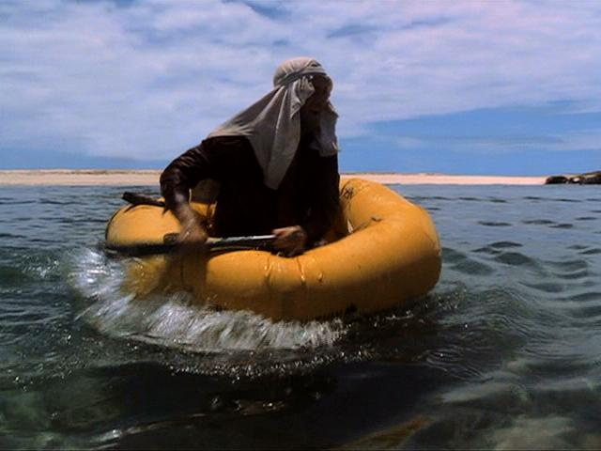
An Accident in the making…
Cast Away Scene 1
DVD Chapter 14
Notes:
Now let’s look at an accident happen in Real Time. How many people have seen the movie Cast Away with Tom Hanks? Give short intro of movie plot an introduce this scene – DVD Chapter 14 “A Light in the Distance”

Slide 20
What were the Causal Factors?
Notes:
Ask audience to come up with causal factors. Write them on a whiteboard placing them into Equipment, Environment, People categories (without labeling the categories) and then ask the audience to come up with the categories. Now they have built the first part of the RASM model.

Slide 21
Hazard Factors
Equipment
Environment
People
No Food Water
Fear / Anxiety
Paddle
Huge Waves
Indecisive
Raft
Coral Reef
No Plan
Notes:
Go through each of the “Hazard Balls” for the Cast Away example.
Let's take a look at a working model of this that will show how these factors all interact to create a dynamic risk level.

Slide 22
Risk Assessment & Safety Management Model (RASM) ©
Environment
People
Equipment
Low
High
Risk Level
Notes:
So let's take a look at the overall risk assessment and safety management model in the following graphic. What you see here can be thought of as a simple balance scale. If we look on the left side we see a series of hazard factors that fall into three categories: Environmental Hazards, Equipment Hazards, and People Hazards (aka Human Factor Hazards) . In the center we see risk levels. As Hazard Factors accumulate on the left-hand side of balance scale, here shown as adding balls into the cylinders, the piston in the Risk Level cylinder moves to the right. Increasing the risk level doesn’t mean that you are going to have an accident, just that the potential for having an accident is increasing.
In the case of Tom Hanks and Cast Away scene if I land 1 foot to the left of the coral reef and am uninjured, what is the Risk Level? Answer – it is the same. This is a Close Call not an Accident but the Risk Level for having the accident occur is the same.
This is a place to remind people of the Risk Formula:
Probability * Severity = Risk Level

Slide 23
Climbing Hazard Factors
Equipment Hazards
Equipment wear/abrasion
Hardware failure
Beyond lifespan
Power tools
Inadequate flooring
Environmental Hazards
Sharp edges
Falling objects
Noisy
Poor sight lines
Inadequate ventilation
Chalk dust
Faulty wiring

Slide 24
Climbing Hazard Factors
Human Factor Hazards
Poor technique
Inadequate supervision
Poor training
Over training
Incorrect tie-in
Back-clipping
Gym Culture
Inadequate screening
Medical Conditions
Fatigue
Poor Communication
Fear/Anxiety

Slide 25
How “Big” are Hazards
We can think of Hazards as Balls which have a certain size and weight. The greater the ‘mass’ the greater the potential impact.
If a particular Hazard might have multiple impacts/negative consequences, then the total possible impact of that Hazard is adding the scores (Probability of A) * (Severity of A) + (Probability of B) * (Severity of B)
Example: High Altitude can lead to Pulmonary Edema and to Cerebral Edema. Each one would have it’s own Probability and Severity

Slide 26
Hazard Impact
Analyzing the actual Hazard is essential in determining the extent to which it is a large or small factor.
Potential Consequences of High Altitude
Mild Altitude Sickness
High Altitude Pulmonary Edema (HAPE)
High Altitude Cerebral Edema (HACE)
High Altitude
Notes:
‘Not All Hazards are the Same Size’ – Have the same impact
Calculating the impact of risk is more than just identifying the particular hazard. It’s also important to recognize that some hazards have more impact than others. One formula that is used for calculating the individual risk is
RISK = PROBABILITY OF OCCURENCE * SEVERITY OF OUTCOME
Let’s take the example of High Altitude. There are a number of illnesses associated with High Altitude.
Mild Altitude Sickness
High Altitude Pulmonary Edema (HAPE)
High Altitude Cerebral Edema (HACE)

Slide 27
Hazard Impact = ‘Ball Size’
10,000 feet/3,048 meters
Mild Altitude Sickness Probability Moderate * Severity Low = Low Risk (5*1 = 5) - GREEN
High Altitude Pulmonary Edema (HAPE) Probability Low * Severity High = Moderate Risk (1*9 = 9) - YELLOW
High Altitude Cerebral Edema (HACE) Probability Low * Severity High = Moderate Risk (1* 9 = 9) - YELLOW
High Altitude
Overall Risk Level = 23 (5 + 9 + 9)
Notes:
Let’s see what the impact of this particular Hazard Factor will be at 10,000 feet (3,048 meters).
At 10,000 feet the Probability of Mild Altitude Sickness is moderate but the Severity at this altitude is low so we’ll give it a total value of
Probability Moderate (5) * Severity Low (1) = Low Risk (5) - GREEN
High Altitude Pulmonary Edema (HAPE) is Probability Low (1) * Severity High (9) = Low Risk (9) - YELLOW
High Altitude Cerebral Edema (HACE) is Probability Low (1) * Severity High (9) = Low Risk (9) - YELLOW

Slide 28
Hazard Impact = ‘Ball Size’
18,000 feet/5,486 meters
Mild Altitude Sickness Probability High * Severity Low = Moderate Risk (9*1 = 9) - YELLOW
High Altitude Pulmonary Edema (HAPE) Probability Moderate * Severity High = High Risk (5*8 = 40) - RED
High Altitude Cerebral Edema (HACE) Probability Moderate * Severity High = High Risk (5*9 = 45) - RED
High Altitude
Overall Risk Level = 93 (9 + 40 + 45)
Notes:
At high altitudes the Probability of these illnesses is fairly high and the Severity is high. If we assign some numbers to these we get a Risk Level of 12, a very large ‘ball.’
At 18,000 feet the occurrence of
Mild Altitude Sickness is
Probability High (9) * Severity Low (1) = Moderate Risk (9) - YELLOW
High Altitude Pulmonary Edema (HAPE) is
Probability Moderate (5) * Severity High (8) = High Risk (40) - RED
High Altitude Cerebral Edema (HACE) is
Probability Moderate (5) * Severity High (9) = Low Risk (45) - RED

Slide 29
Hazard Factors - 10,000 ft
High Altitude (23)
Environment
People
Equipment
Low
Risk Level
High
Notes:
So let's take a look at the overall risk assessment and safety management model in the following graphic. What you see here can be thought of as a simple balance scale. If we look on the left side we see a series of hazard factors that fall into three categories: Environmental Hazards, Equipment Hazards, and People Hazards. In the center we see risk levels. As Hazard Factors accumulate on the left-hand side of balance scale, here shown as adding balls into the cylinders, the piston in the Risk Level cylinder will go up. Increasing the risk level doesn’t mean that you are going to have an accident, just that the potential for having an accident is increasing.
This is a place to remind people of the Risk Formula:
Probability * Severity = Risk Level

Slide 30
Hazard Factors – 18,000 ft
High Altitude (93)
Environment
People
Equipment
Low
Risk Level
High
Notes:
So let's take a look at the overall risk assessment and safety management model in the following graphic. What you see here can be thought of as a simple balance scale. If we look on the left side we see a series of hazard factors that fall into three categories: Environmental Hazards, Equipment Hazards, and People Hazards. In the center we see risk levels. As Hazard Factors accumulate on the left-hand side of balance scale, here shown as adding balls into the cylinders, the piston in the Risk Level cylinder will go up. Increasing the risk level doesn’t mean that you are going to have an accident, just that the potential for having an accident is increasing.
This is a place to remind people of the Risk Formula:
Probability * Severity = Risk Level

Slide 31
Managing the Risk Level
So How Do You Reduce the Risk Level?
Remove all the Hazards you can
What if that’s not Enough?
Add Safety Factors
Notes:
So how to you Manage the Risk Level:
Remove all the Hazards you can
Add Safety Factors

Slide 32
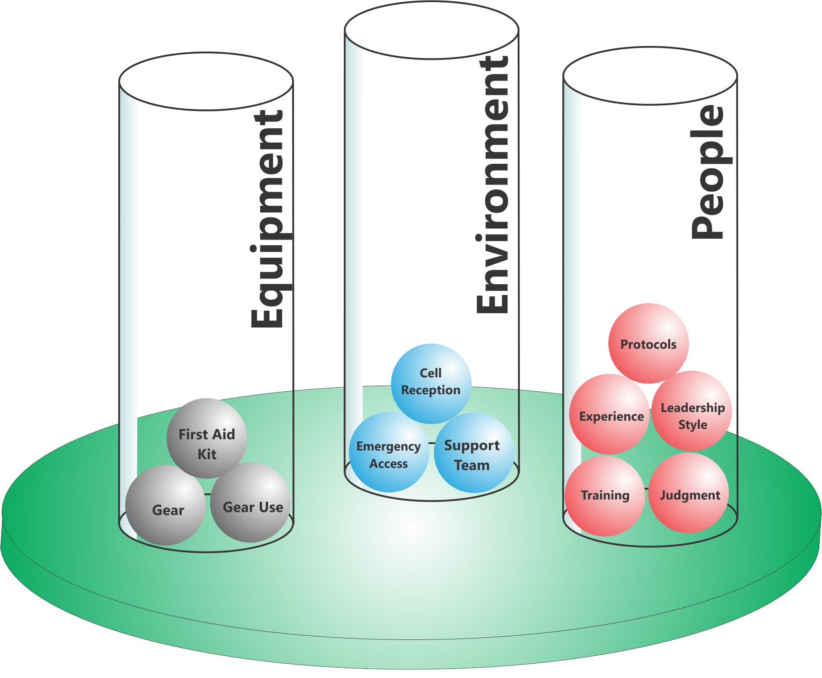
Add Safety Factors
People
Environment
Equipment
Notes:
We can look at adding Safety Factors in the same three areas
Equipment
Environment
People
Going back to our High Altitude Example, what can we do to reduce the risk at 18,000 feet?
Can we eliminate the Hazard Factors (Balls) that are creating the risk? No
What are our other options? Add a Safety Factor
So here is what we did

Slide 33
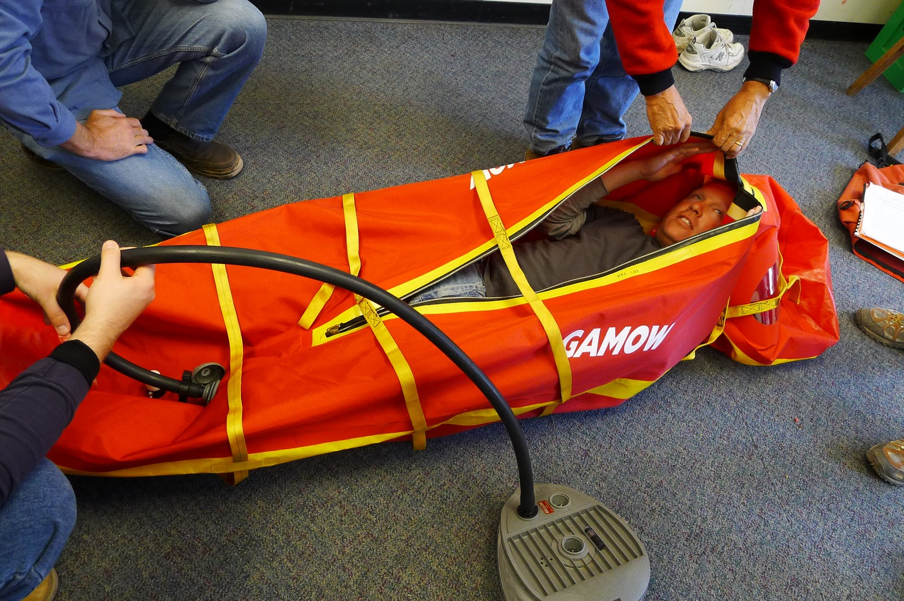
Gamow Bag
Notes:
Explain what a Gamow bag does.

Slide 34
Risk Assessment & Safety Management Model (RASM) ©
Environment
People
Equipment
Low
High
Risk Level
Notes:
Now we are seeing the other side of the RASM model.
On the right side we now see another part of the balance scale−the Safety Factors−in three categories as before: Environmental Safety Factors, Equipment Safety Factors, and People Safety Factors. When we add “balls” into the Safety Factors we make the risk level go down. Of course it will never go to zero, but we can reduce the risks by adding Safety Factors in.

Slide 35
Safety Factors also have “Weight”
Big Safety Factors have a greater impact on the Risk Level than Small Safety Factors

Slide 36
Risk Assessment & Safety Management Model (RASM) ©
Environment
Environment
People
People
Equipment
Equipment
Low
High
Risk Level
Notes:
So now we are back at the overview of the model and I think you have a good sense of the dynamic interaction that this model provides.
Now let’s put it all together. The Hazard Factors operate to push the Risk Level up while the Safety Factors operate to pull the risk level down. For simplicities sake on the illustrations, all the balls are shown as the same size. As we’ve shown some may be much larger than others and ‘weigh more’ having a much greater or lesser influence on the ultimate Risk Level. For example having a hurricane hit your trip is a massive hazard factor made up of a series of conditions (high winds, downed trees, flooding, temperature, etc.)

Slide 37
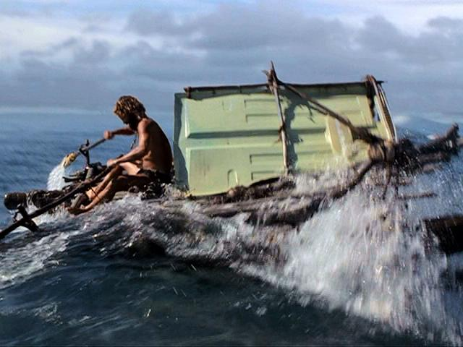
An Accident in the Making - 2
Cast Away Scene 2
DVD Chapter 23
Notes:
Give a summary of what has transpired in the movie up to this point – He survives for 1500 days.
Now watch what happens this time and see what is different from his previous attempt.

Slide 38
Hazard Factors
Equipment
Environment
People
No Food Water
Fear / Anxiety
Paddle
Huge Waves
Indecisive
Raft
Coral Reef
No Plan
Notes:
Explain how he has reduced the Hazard Factors

Slide 39
Safety Factors
Equipment
Environment
People
Sail
Determined
Food Water
Decisive
Paddles
Wind
Plan
Raft
Notes:
Explain how he has increased Safety Factors.
Is his Risk Level 0 – No, but for him, in this situation, it is an Acceptable Level of Risk
Acceptable Risk has to be defined by each program and each individual activity like the R- R+ we discussed before

Slide 40
Risk Assessment & Safety Management Model (RASM) ©
Environment
Environment
People
People
Equipment
Equipment
Low
High
Risk Level
Notes:
So now we are back at the overview of the model and I think you have a good sense of the dynamic interaction that this model provides.
Now let’s put it all together. The Hazard Factors operate to push the Risk Level up while the Safety Factors operate to pull the risk level down. For simplicities sake on the illustrations, all the balls are shown as the same size. As we’ve shown some may be much larger than others and ‘weigh more’ having a much greater or lesser influence on the ultimate Risk Level. For example having a hurricane hit your trip is a massive hazard factor made up of a series of conditions (high winds, downed trees, flooding, temperature, etc.)

Slide 41
If the Risk Level is still too High?
Know when to ‘bail out’
If the Risk Level is too high, what is your expectation of your staff and what is their expectation?
Notes:
Ask the class what happens when the Risk Level is high and you cannot bring it down to an acceptable level by reducing Hazard Factors or adding Safety Factors. The answer is to bail out. I give a detailed example from my program where leaders have made a good decision by bailing out. They looked at the situation and determined that there was no way to continue without a significant level of risk.
When you can’t bring the risk down, look at ‘changing the game.’

Slide 42
7 Steps in RASM
Identify Hazard Factors
Assess Risk Level
Remove Hazard Factors
Assess Risk Level
Add Safety Factors
Assess Risk Level
Bail Out

Slide 43
Learning Zone Model
Comfort Zone GO
Learning Zone CAUTION
Panic Zone STOP
Notes:
Many of us use the Learning Zone Model of
Comfort Zone
Learning Zone
Panic Zone
Explain these are Go, Caution, Stop.
The optimal learning takes place in the Learning Zone where there is some level of discomfort. When people move into the Panic Zone, their risk level increases dramatically. Tell stories:
Example: Catskills Hiking Story
Arachnophobia & Tent

Slide 44
Diversity & Inclusion Risks
Physical Safety is only one dimension on the Risk Management spectrum
Emotional Safety is equally important and Hazards can be equally life threatening
Talk to your staff about where there are Emotional/Interpersonal Hazards, Assess the Risk Level, and establish the necessary guidelines, structures, protocols, and culture to manage the risk

Slide 45
Sexual Harassment & Assault Risks
Are you operating a safe workplace for employees?
Are you operating a safe environment for clients?
Are you dealing with minors – especially in coaching situations?
Penn State – Jerry Sandusky child abuse case
Michigan State – Larry Nassar abuse case

Slide 46
Risk Assessment & Safety Management Model (RASM) ©
Environment
Environment
People
People
Equipment
Equipment
Low
High
Risk Level
Notes:
So now we are back at the overview of the model and I think you have a good sense of the dynamic interaction that this model provides.
Now let’s put it all together. The Hazard Factors operate to push the Risk Level up while the Safety Factors operate to pull the risk level down. For simplicities sake on the illustrations, all the balls are shown as the same size. As we’ve shown some may be much larger than others and ‘weigh more’ having a much greater or lesser influence on the ultimate Risk Level. For example having a hurricane hit your trip is a massive hazard factor made up of a series of conditions (high winds, downed trees, flooding, temperature, etc.)

Slide 47
Incident Data Collection & Analysis
Collecting Data is critical to your overall risk management plan
Far more near misses than incidents so document these as well
Develop of culture where incident reporting is the accepted norm
Make incident review discussions part of staff training
Need tools for incident tracking & analysis

Slide 48
Discussion
What is the “typical” Risk Level our program operates at? How much variation is there?
Do our Safety Factors outweigh our Hazard Factors?
How often do we shift into a higher Risk Level on a program?
Are we set up to allow protocols to change as we shift into different Risk Levels?
What do we need to do to implement this system in our organization?
Notes:
These are some important discussion questions to have the group discuss.

Slide 49
Small Group Discussion…
Look at one example of physical risk in your setting and analyze the Hazard Factors, Risk Level and potential Safety Factors
Look at one example of emotional risk in your setting and analyze the Hazard Factors, Risk Level and potential Safety Factors

Slide 50
Implementation: Program Level
Look at each activity you do and assess…
Hazard Factors in each of these categories…
Environment
Equipment
People
Safety Factors in each of these categories…
Environment
Equipment
People
What Risk Level(s) you are comfortable operating with and are appropriate for your program goals?
Notes:
This slide explores how to implement the RASM model in your program. For each activity (backpacking, rock climbing, etc.) you should
Assess the Hazard Factors
Environmental Hazard Factors
Equipment Hazard Factors
People Hazard Factors
Assess your Safety Factors to deal with the potential hazards
Environmental Safety Factors
Equipment Safety Factors
People Safety Factors
Decide if the Risk Level is acceptable
Based on your assessment you need to decide if this activity can be done at an acceptable risk level given your program’s resources.

Slide 51
Implementation: Staff Level
Pre-trip
Assess the Hazard Factors
Environmental Hazard Factors
Equipment Hazard Factors
People Hazard Factors
Prepare an Hazard Briefing for participants
Assess your Safety Factors to deal with the potential hazards
Environmental Safety Factors
Equipment Safety Factors
People Safety Factors
Decide if the Risk Level is acceptable
Notes:
Once you are doing an activity before a trip goes out you need to have field staff run through this same process.
Assess/Review the Hazard Factors
Environmental Hazard Factors
Equipment Hazard Factors
People Hazard Factors
Prepare an Hazard Briefing for participants
What do they need to know to keep themselves safe
Assess/Review your Safety Factors to deal with the potential hazards
Environmental Safety Factors
Equipment Safety Factors
People Safety Factors

Slide 52
Implementation: Staff Level
During the Trip
Teach the RASM Model to Participants
Assess
Environmental Hazards
People Hazards
Equipment
Increasing Risk Level/Accident Potential
“Treat” all the Hazards you can
Add additional Safety Factors if necessary/possible
Reassess Risk Level
If it’s still too high, change things
Notes:
During the trip leaders should use the RASM model to regularly assess the situation for Hazard Factors and for increasing Risk Levels. Using a standard medical model you should “treat” (remove) all the Hazard Factors you can and “treat” (add) all the Safety Factors you can and then reassess the situation.
I remind people of the Patient Assessment System (PAS) taught in many first aid courses. This is a model that they probably know already and RASM mirrors this approach. Giving them another tool that syncs with logical frameworks they already use helps them remember.

Slide 53
Implementation: Post Program
After the Trip
Turn in Incident/Near Miss Reports
Review events with staff
Assess need for program changes: protocols, training, resources, etc.
Notes:
Gathering data for both accidents and close calls is essential to get the full picture of potential risk. Remind people about the Accident Iceberg and any examples you gave there.
Using whatever your program’s format is people should turn in both accident reports and close call reports. This is a time to reinforce with leaders how critical this is to overall risk management.
Note: People interested in tools for collecting and managing incident data should refer to the International Incident Database Project (www.incidentdatabase.org)

Slide 54
Implementing RASM
Look at each activity you do and assess…
Hazard Factors in each of these categories…
Environment
Equipment
People
Safety Factors in each of these categories…
Environment
Equipment
People
What Risk Level(s) you are comfortable operating with and are appropriate for your program goals?
Notes:
This slide explores how to implement the RASM model in your program. For each activity (backpacking, rock climbing, etc.) you should
Assess the Hazard Factors
Environmental Hazard Factors
Equipment Hazard Factors
People Hazard Factors
Assess your Safety Factors to deal with the potential hazards
Environmental Safety Factors
Equipment Safety Factors
People Safety Factors
Decide if the Risk Level is acceptable
Based on your assessment you need to decide if this activity can be done at an acceptable risk level given your program’s resources.

Slide 55
Take Home Action Steps
For each program activity brainstorm a list of Hazard Factors in each of the three major categories (Environment, Equipment, People)
For each program activity brainstorm a list of Safety Factors in each of the three major categories (Environment, Equipment, People) designed to mitigate against Hazard Factors

Slide 56
Take Home Action Steps
Balance the Hazard Factors against the Safety Factors and determine the range of Risk Levels you will be operating in. Based on your program, decide whether the Risk Level is acceptable or not.
If the Risk Level is not acceptable, assess how to modify Hazard Factors and Safety Factors to reduce the Risk Level.
Have your students think about how this model applies to their lives back on campus – for example seeing someone who is severely intoxicated
Notes:
If you see something, say something. This is Bystander Intervention back on campus. If you see something that is a potential hazardous situation and you don’t intervene, what are you? You are a Hazard Ball (People Hazard). I remind my students that others know that they are outdoor program leaders and know first aid and CPR. If they see you not reacting, they may assume that it’s not a hazardous situation. Leadership is about stepping up even when it’s difficult.

Slide 57
Final Thoughts
Final Thoughts
The biggest mistake
about a mistake
is not learning from it

Slide 58
Cloud-based Risk Management Solutions
IncidentAnalytix Incident Database Tracking & Analytics in the Cloud
Cloud Hosted
Enterprise Solution
Real-time Analytics
We provide a complete Cloud-Hosted Solution on the Microsoft Azure Cloud Platform including fault-tolerant servers, database backup and recovery and Web application firewall security.
Designed from the ground up as a fully-integrated software-as-a-service solution using the latest software design patterns, continuous deployment, robust security, user-friendly interface and more.
Our unique user interface allows your users to easily drill into your data. Our Power BI Analytics integration gives you real-time analysis of trends and patterns.

Slide 59
Resources
www.IncidentAnalytix.com
www.OutdoorEd.com
Search for RASM
Copyright © 2019 Rick Curtis, Outdoor Ed LLC. All rights reserved.

