Slide 1
Risk Assessment &
Safety Management (RASM)
Teaching Staff to Manage Program Safety through Active Leadership
Rick Curtis
www.OutdoorEd.com
Princeton University Outdoor Action Program
Copyright © Rick Curtis 2016
Notes:
Introduction

Slide 2
Introduction
Rick Curtis
Pronouns: he, him, his
Director, Princeton University Outdoor Action Program: 38 Years
Author: The Backpacker’s Field Manual
Founder: www.OutdoorEd.com
Founder: www.IncidentAnalytix.com

Slide 3
Workshop Design
The purpose of this workshop at the is to prepare you to teach this same workshop to your staff. The workshop typically takes 1-2 hours and is compressed to meet the conference time limit.
As a result, there isn’t time (with these stated goals) to do a deep dive into the RASM Model at the Program Administration level. There is a detailed article about the concept at OutdoorEd.com that provides a lot of that level of material (search for Risk Management).
Notes:
The objectives of this presentation are to:
Define Risk
Identify the major causal factors in accidents/near misses
Explore a model for managing risk that incorporates the major causal factors
Identify best practices for assessing and managing risk before an event
Identify procedures for evaluating risk and mitigating it in the field

Slide 4
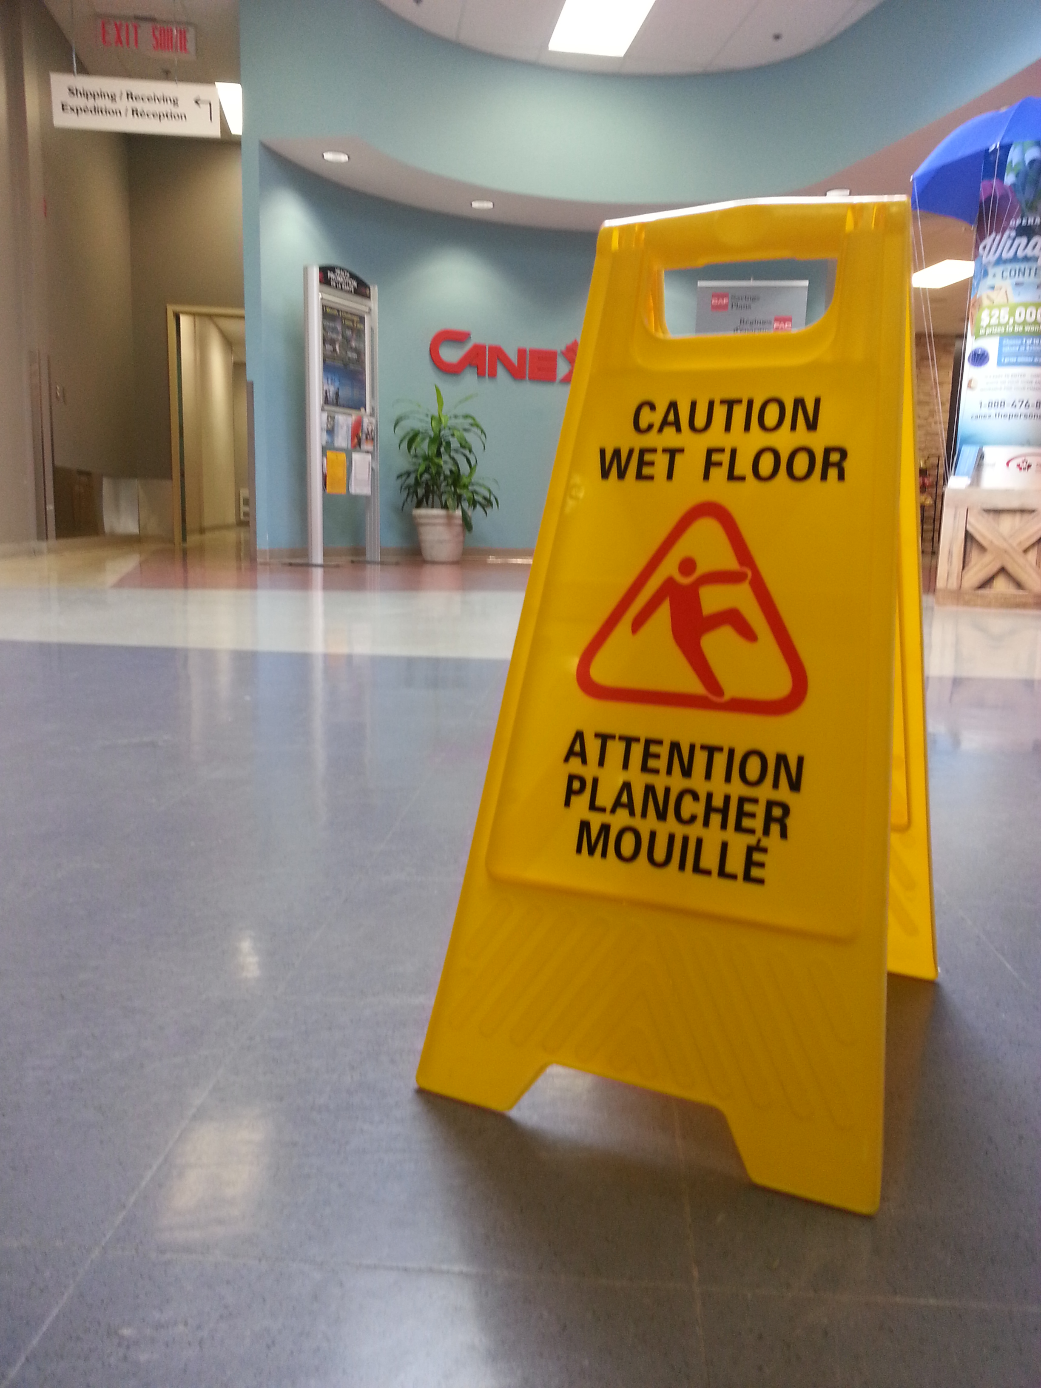
Risk Management is not just…

Slide 5
Learning Objectives
Provide you with a complete training module for your staff
Identify the major causal factors in accidents/near misses
Explore a model for managing risk that incorporates the major causal factors
Identify methods for assessing and managing risk before an event
Identify methods for evaluating risk and mitigating it in the field
Notes:
The objectives of this presentation are to:
Provide you with a complete training module for your staff
Identify the major causal factors in accidents/near misses
Explore a model for managing risk that incorporates the major causal factors
Identify methods for assessing and managing risk before an event
Identify methods for evaluating risk and mitigating it in the field

Slide 6
What is an Incident?
Incident
Close Call/Near Miss
Notes:
Ask the audience to define an Incident. Bring up the difference between an Incident and a Close Call/Near Miss.

Slide 7
Types of Incidents
Injury
Illness
Motivational/Behavioral
Behavioral
Bias
Crime
Harassment
Sexual Contact
Property Damage

Slide 8
Defining Risk/Reward
-R: Negative R (Risk) is the potential for loss, injury, illness
+R: Positive R (Reward) is the potential for gain, growth, development
Notes:
In this model there are two different types of risk the first is what I call Negative R(isk) or Negative R. Negative R is the potential for loss injury or illness which is what we typically associate with accidents in the field. Positive R(isk) or Positive R is the potential for gain growth and development. So in all of our programs, we have both Negative R and Positive R.
We all know about the negative model of risk, what is the positive side of risk in our industry? Risk is an underlying principal in all of outdoor and adventure education. The fundamental philosophical principles of Kurt Hahn and others is that the exposure to risk/challenge is what impels people to personal growth.
Each program has to evaluate the level of Negative R that is appropriate for your organization's mission. For example, in my work running wilderness orientation programs for incoming college freshmen, the level of Negative R that is appropriate to accomplish our mission is low. However, if I am working in a therapeutic program with serious drug offenders, the consequences for them not getting off drugs have huge Negative R so I would tolerate running a program that might have a higher Negative R in order to influence behavior change.

Slide 9
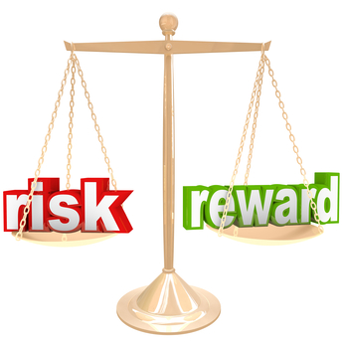
Balancing Risk/Reward

Slide 10
Risk is…
Inherent: -R exists in outdoor adventure activities
Expected: -R can occur at any time
Integral: -R and +R are essential parts of our program
Determine the appropriate level of –R for your program
Notes:
So risk is inherent in our programs. That is Negative R exists in all adventure activities.
Risk is expected. Negative R can occur at any time so we have to expect the unexpected.
Risk is manufactured. We plan programs with the understanding that there is some Negative R. In fact our programs wouldn't function without some level of Negative R.
And finally risk is integral. Both Negative R and Positive R are essential parts of our programs.

Slide 11
Risk is…
Inherent: -R exists in outdoor adventure activities
Expected: -R can occur at any time
Integral: -R and +R are essential parts of our program
Notes:
So risk is inherent in our programs. That is Negative R exists in all adventure activities.
Risk is expected. Negative R can occur at any time so we have to expect the unexpected.
Risk is manufactured. We plan programs with the understanding that there is some Negative R. In fact our programs wouldn't function without some level of Negative R.
And finally risk is integral. Both Negative R and Positive R are essential parts of our programs.

Slide 12
How do we Manage Risk?
The Risk Assessment & Safety Management Model (RASM) takes into account the negative causation factors (Hazards) of other models
It also adds in positive Safety Factors which interact dynamically with the Hazard Factors to alter the Risk Level
Managing risk can be achieved by both reducing Hazard Factors and/or adding Safety Factors
Notes:
The Risk Assessment and Safety Management model (RASM) takes into account the negative causation factors or hazards of previous models but it also adds in positive safety factors which interact dynamically with a hazard factors to alter the risk level. That means that managing risk can be accomplished by both reducing hazard factors and also by adding safety factors in the equation, something the earlier models didn’t focus on.

Slide 13
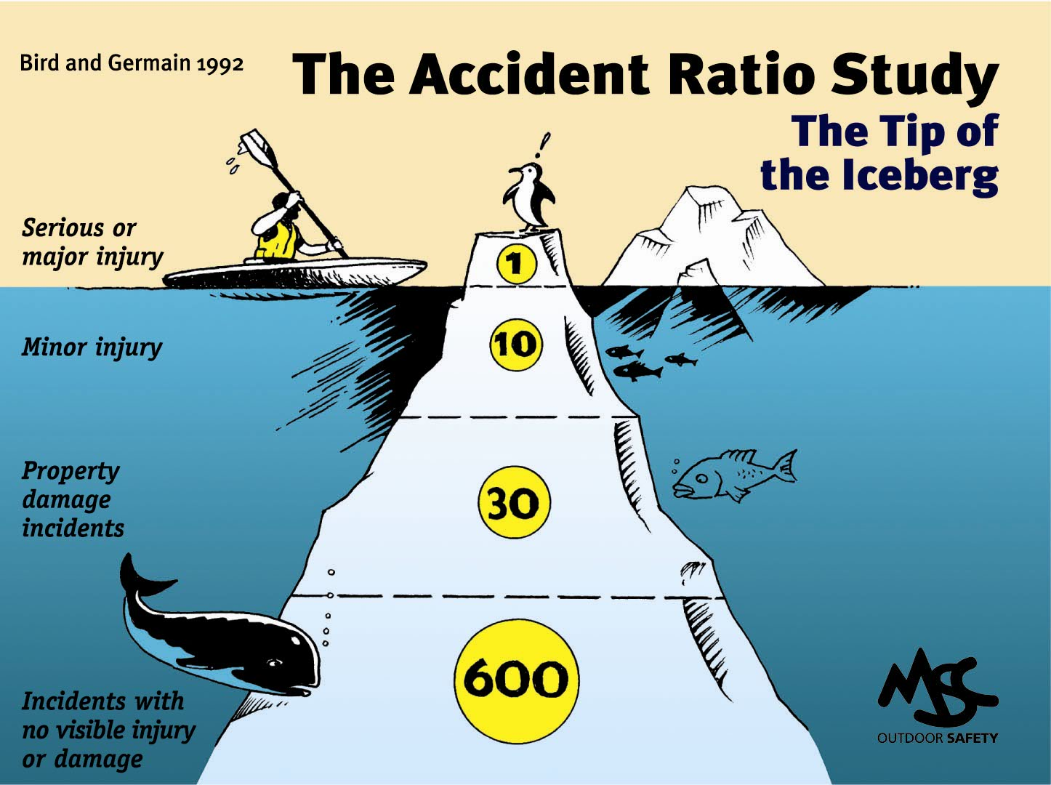
The Accident Iceberg
Notes:
Some of you may be familiar with what is called the Accident Iceberg or the Accident Pyramid. What do we know about in Iceberg – that 90% is actually underwater and can’t be seen. This is based on the work of Bird and Germain studying accidents in industrial settings. It has been replicated in 2003 by Conoco Philips and is generalized here for the outdoor industry.
Their research showed that for every serious or major injury there would be 10 minor injuries, 30 cases of property damage and 600 close calls. Based on this model what is the most predictive data point for the Risk Level of a particular activity – the near misses.

Slide 14
Risk Level
Risk Levels are levels of increasing risk and therefore increased potential for accidents.
Risk Level is assigned to an ascending scale of 1 to 5 (arbitrary).
The interaction of Hazard Factors and Safety Factors creates the Risk Level.
There is no such thing as an overall Risk Level of Zero.
Notes:
Risk Levels are levels of increasing risk and therefore increased potential for accidents.
Risk Level is assigned to an ascending scale of 1 to 5 (arbitrary).
The interaction of Hazard Factors and Safety Factors creates the Risk Level.
There is no such thing as a Risk Level of Zero. – in any activity the overall risk level cannot be zero

Slide 15
Risk Formula
Probability * Severity
= Risk Level
Notes:
The formula for determining the level of Risk is
RISK = PROBABILITY OF OCCURENCE * SEVERITY OF OUTCOME

Slide 16
Risk Formula
How Likely? * How Bad?
= Risk Level
Notes:
The formula for determining the level of Risk is
RISK = PROBABILITY OF OCCURENCE * SEVERITY OF OUTCOME

Slide 17
Risk Level Matrix
Probability | High
 | Medium
 | Low
 |  | Low | Medium | High
 | Severity of Consequences

Slide 18
Risk Calculator

Slide 19
Learning Zones
Comfort Zone
GO
Learning Zone
CAUTION
Panic Zone
STOP
Notes:
Many of us use the Learning Zone Model of
Comfort Zone
Learning Zone
Panic Zone
Explain these are Go, Caution, Stop.
The optimal learning takes place in the Learning Zone where there is some level of discomfort. When people move into the Panic Zone, their risk level increases dramatically. Tell stories:
Example: Catskills Hiking Story
Arachnophobia & Tent

Slide 20
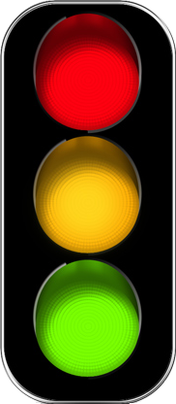
Assess your Risk Level
Red Light
Yellow Light
Green Light
Stop
Caution
Go
Notes:
If we do

Slide 21
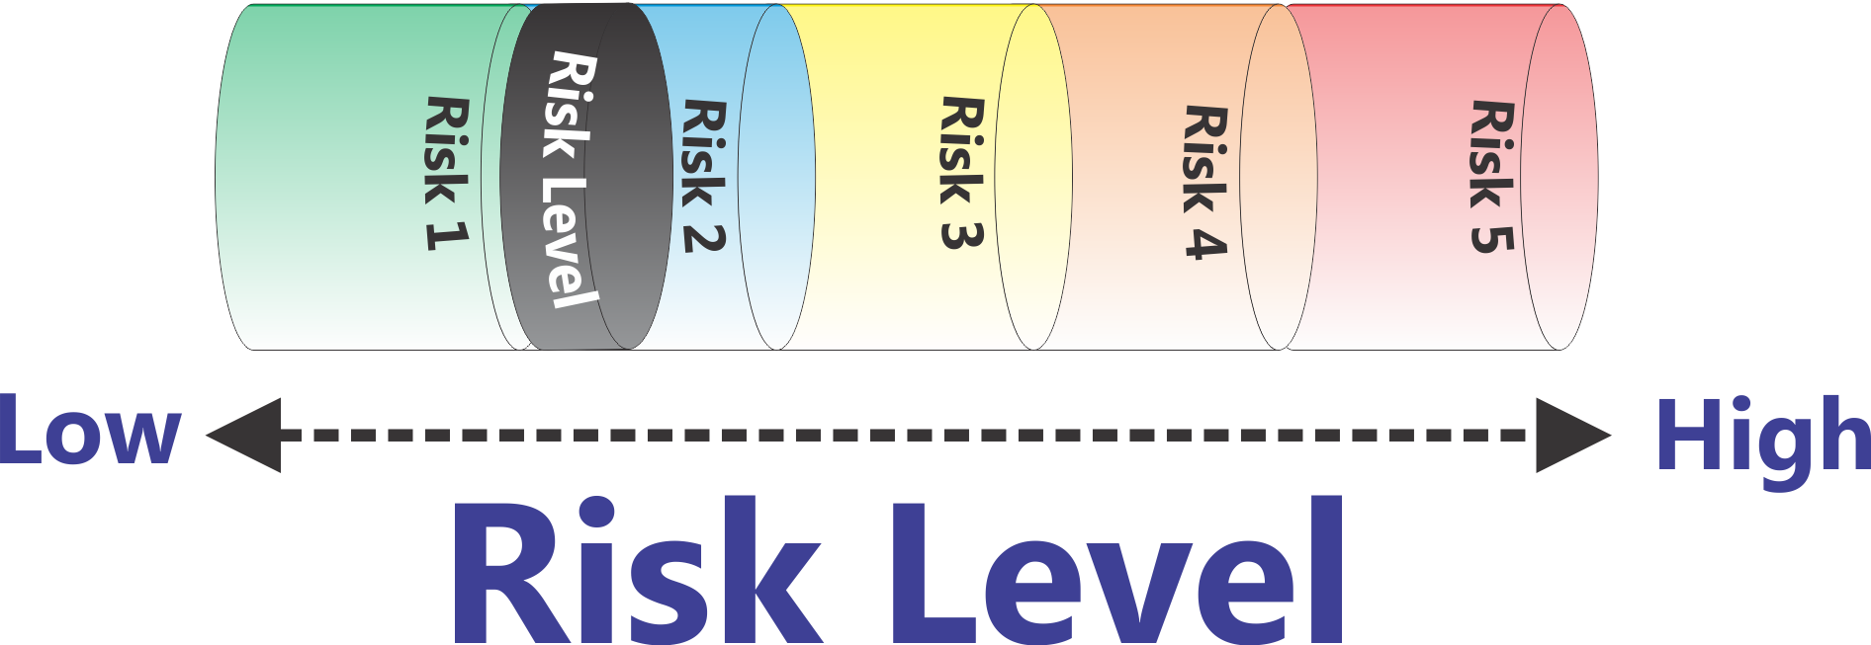
‘Flattened’ Matrix
Low
High
Risk Level
Notes:
Here is a representation of increasing Risk Levels. As the Risk goes up (Probability * Severity) then the piston goes up.
In this particular demonstration of the RASM model we are arbitrarily setting the risk level with a scale of one to five. What risk scale you actually use is up to you. This five point scale is based on the U.S. Department of Homeland Security Threat (Risk) Advisory level. (Low - Green, Guarded - Blue, Elevated - Yellow, High – Orange, Severe – Red)
Can the risk level ever be zero? No, there is no such thing as a risk level of zero. Whenever we send out a trip or run a program there is some level of risk. The question is to determine at an organizational level what level of risk you are comfortable operating your program at.

Slide 22
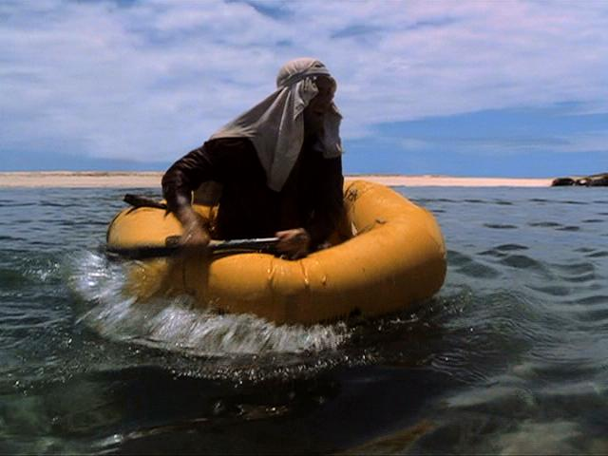
An Accident in the making…
Cast Away Scene 1
DVD Chapter 14
Notes:
Now let’s look at an accident happen in Real Time. How many people have seen the movie Cast Away with Tom Hanks? Give short intro of movie plot an introduce this scene – DVD Chapter 14 “A Light in the Distance”

Slide 23
What were the Causal Factors?
Notes:
Ask audience to come up with causal factors. Write them on a whiteboard placing them into Equipment, Environment, People categories (without labeling he categories) and then aske he audience to come up with the categories.

Slide 24
Hazard Factors
Equipment
Environment
People
No Food Water
Fear / Anxiety
Paddle
Huge Waves
Indecisive
Raft
Coral Reef
No Plan
Notes:
Go through each of the “Hazard Balls” for the Cast Away example.
Let's take a look at a working model of this that will show how these factors all interact to create a dynamic risk level.

Slide 25
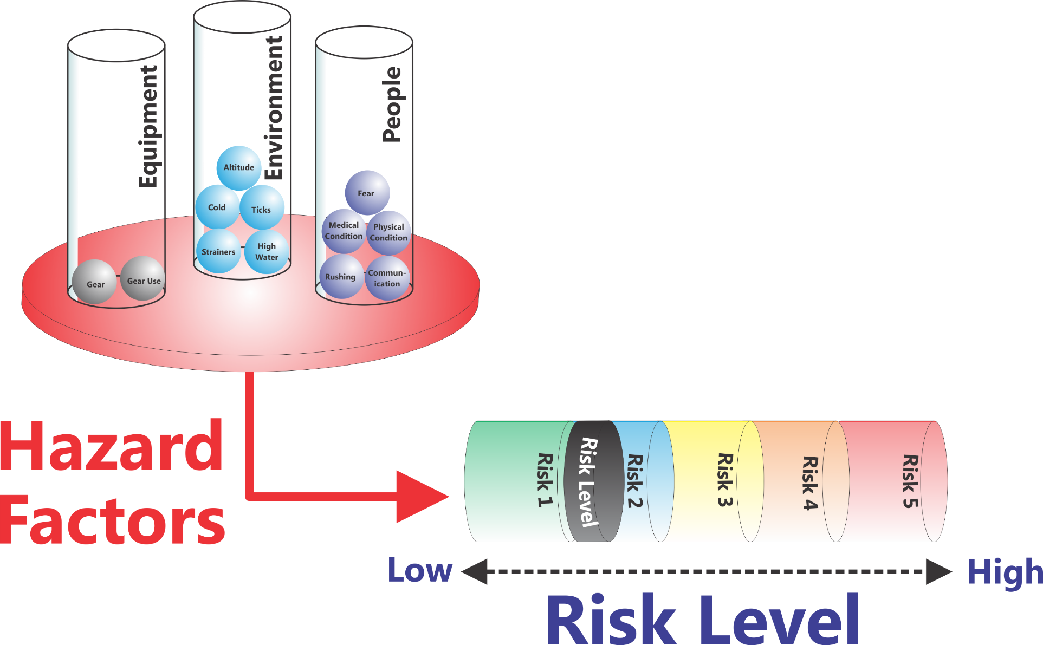
Risk Assessment & Safety Management Model (RASM) ©
Environment
People
Equipment
Low
High
Risk Level
Notes:
So let's take a look at the overall risk assessment and safety management model in the following graphic. What you see here can be thought of as a simple balance scale. If we look on the left side we see a series of hazard factors that fall into three categories: Environmental Hazards, Equipment Hazards, and People Hazards (aka Human Factor Hazards) . In the center we see risk levels. As Hazard Factors accumulate on the left-hand side of balance scale, here shown as adding balls into the cylinders, the piston in the Risk Level cylinder moves to the right. Increasing the risk level doesn’t mean that you are going to have an accident, just that the potential for having an accident is increasing.
In the case of Tom Hanks and Cast Away scene if I land 1 foot to the left of the coral reef and am uninjured, what is the Risk Level? Answer – the same.This is a Close Call not an Accident but the Risk Level for having the accident occur is the same.
This is a place to remind people of the Risk Formula:
Probability * Severity = Risk Level

Slide 26
Hazard Factors
Environment
  High Water
  High Temperatures
  Lightning
Equipment
  Improper gear
  Broken equipment
People
  Medical Conditions
  Fatigue
  Poor Communication
  Fear/Anxiety
Notes:
The actual “balls” that you put into the model are going to be dependent on the types of activities you are doing, your location, etc. Here are some examples of factors (balls) in the Environment, Equipment, and People Hazard categories.
If you want to get more detailed about this you can have the group brainstorm examples of the different categories of Hazard Factors. You can also break the People Factors into different populations (people hazards for everyone in the group, people hazards for participants, people hazards for leaders, and people hazards for the entire group). There are some slides of this in the appendix.

Slide 27
How “Big” are Hazards
We can think of Hazards as Balls which have a certain size and weight.
Big Hazards have a greater impact on the Risk Level than Small Hazards

Slide 28
Hazard Impact
Analyzing the actual Hazard is essential in determining the extent to which it is a large or small factor.
Potential Consequences of High Temperature
Dehydration
Heat Exhaustion
Heat Stroke
Air Tempe-rature
Notes:
‘Not All Hazards Balls are the Same Size’ = Have the same impact
Calculating the impact of risk is more than just identifying the particular hazard. It’s also important to recognize that some hazards have more impact than others. One formula that is used for calculating the individual risk is
RISK = PROBABILITY OF OCCURENCE * SEVERITY OF OUTCOME
Let’s take the example of High Temperature. There are a number of illnesses associated with High Temperature.
Dehydration
Heat Exhaustion
Heat Stroke
The scenario is a late August football camp. Students are just back for training. They are wearing heavy uniforms and the humidity is high.

Slide 29
Hazard Impact = ‘Hazard Ball Size’
80° F/ 27° C
Dehydration
Probability Moderate * Severity Low = Moderate Risk (5)
Heat Exhaustion
Probability Low * Severity High =
Moderate Risk (20)
Heat Stroke
Probability Very Low * Severity High = Low Risk (1)
Air Temper-ature
Notes:
Let’s see what the impact of this particular Hazard Factor will be at 80 degrees F (27 degrees C). For this example the actual numbers are not based on any real scale (or the 1-5 scale) but merely serve to illustrate the point.
Working out in a football uniform at 80 degrees F with high humidity feet the chance of dehydration is moderate but the severity at this temperature is low so we’ll give it a total value of
Probability Moderate (5) * Severity Very Low (1) = Moderate Risk (5)
Heat Exhaustion is
Probability Low (2) * Severity High (10) = Moderate Risk (20)
Heat Stroke is
Probability Very Low (0.1) * Severity High (10) = Low Risk (1)

Slide 30
Hazard Impact = ‘Hazard Ball Size’
100° F/ 38° C
Dehydration
Probability High * Severity Low = Moderate Risk (5)
Heat Exhaustion
Probability Moderate * Severity High =
High Risk (30)
Heat Stroke
Probability Moderate * Severity Very High = Very High Risk (50)
Air Temper-ature
Notes:
Let’s see what the impact of this particular Hazard Factor will be at 100 degrees F (38 degrees C). For this example the actual numbers are not based on any real scale (or the 1-5 scale) but merely serve to illustrate the point.
Working out in a football uniform at 100 degrees F with high humidity feet the chance of dehydration is moderate but the severity at this temperature is low so we’ll give it a total value of
Probability Moderate (5) * Severity Very Low (1) = Moderate Risk (5)
Heat Exhaustion is
Probability Moderate (3) * Severity High (10) = High Risk (30)
Heat Stroke is
Probability Moderate (5) * Severity High (10) = Very High Risk (50)

Slide 31
Hazard Factors - 80° F/ 27° C
Air Tempe-rature
Environment
People
Equipment
Low
High
Risk Level
Notes:
At 80 degrees F (27 degrees C) the air temperature (combined with humidity, heavy equipment, new students on the team, team culture, etc) makes this a moderate hazard ball.

Slide 32
Hazard Factors – 100° F/ 38° C
Air Tempe-rature
Environment
People
Equipment
Low
High
Risk Level
Notes:
At 100 degrees F (38 degrees C) the air temperature (combined with humidity, heavy equipment, new students on the team, team culture, etc) makes this a really BIG hazard ball.

Slide 33
Hazard Factors
Equipment
Environment
People
No Food Water
Fear / Anxiety
Helmet
Humidity
Inexperien-ced
Uniform
Air Temp
Dehyd-rated
Notes:
Explain how he has reduced the Hazard Factors

Slide 34
Managing the Risk Level
So How Do You Reduce the Risk Level?
  Remove all the Hazards you can
  What if that’s not Enough?
  Add Safety Factors
Notes:
So how to you Manage the Risk Level:
Remove all the Hazards you can
Add Safety Factors

Slide 35
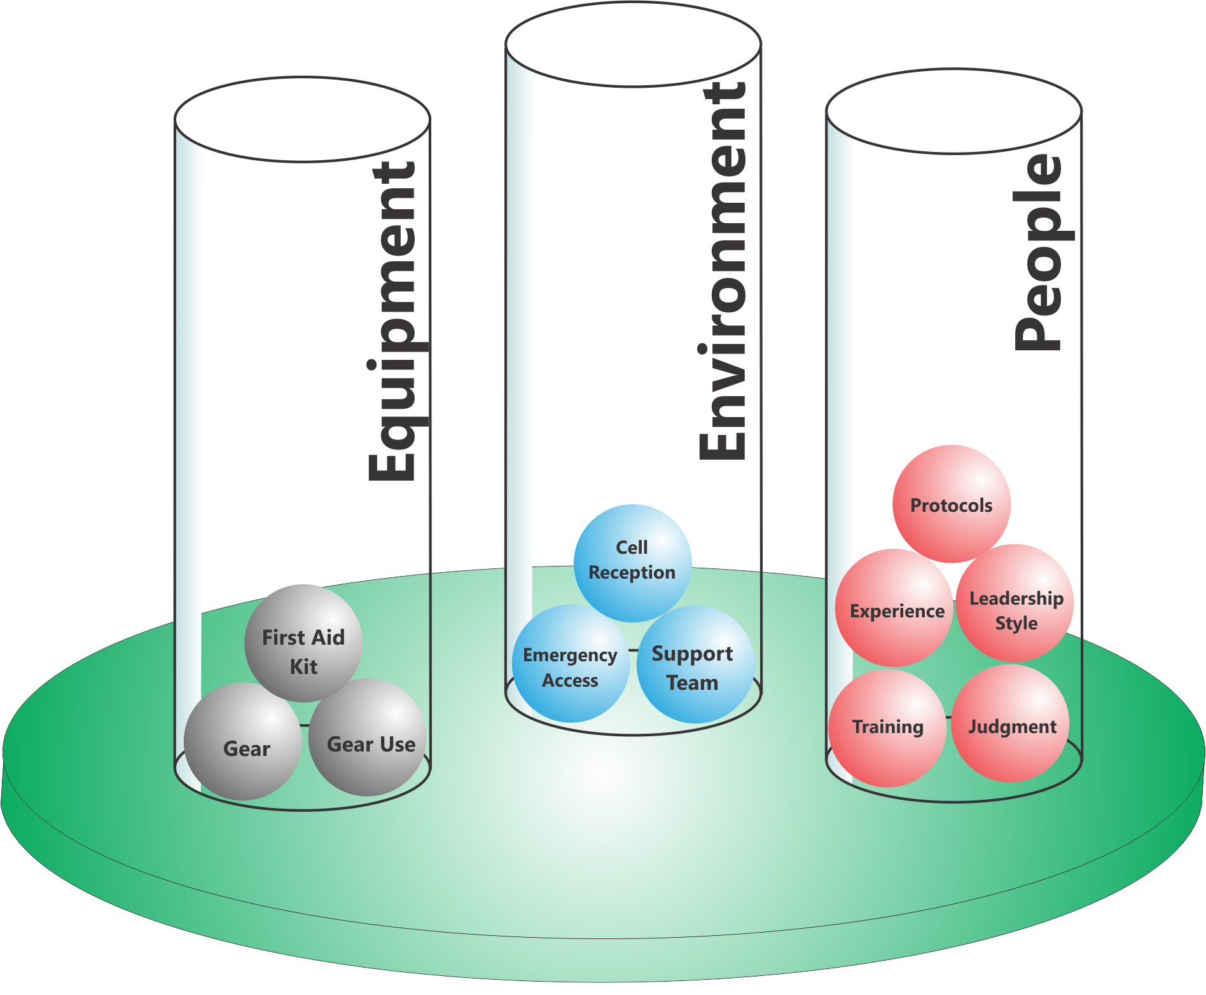
Add Safety Factors
People
Environment
Equipment
Notes:
We can look at adding Safety Factors in the same three areas
Equipment
Environment
People
Going back to our High Altitude Example, what can we do to reduce the risk at 18,000 feet?
Can we eliminate the Hazard Factors (Balls) that are creating the risk? No
What are our other options? Add a Safety Factor
So here is what we did

Slide 36
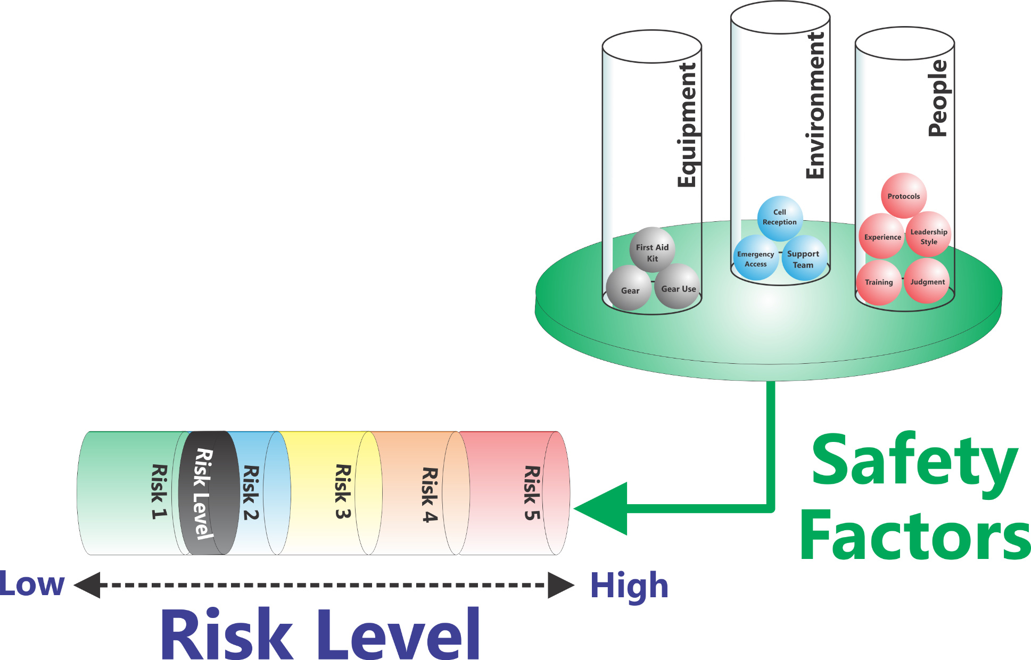
Risk Assessment & Safety Management Model (RASM) ©
Environment
People
Equipment
Low
High
Risk Level
Notes:
Now we are seeing the other side of the RASM model.
On the right side we now see another part of the balance scale−the Safety Factors−in three categories as before: Environmental Safety Factors, Equipment Safety Factors, and People Safety Factors. When we add “balls” into the Safety Factors we make the risk level go down. Of course it will never go to zero, but we can reduce the risks by adding Safety Factors in.

Slide 37
Safety Factors also have “Weight”
Big Safety Factors have a greater impact on the Risk Level than Small Safety Factors

Slide 38
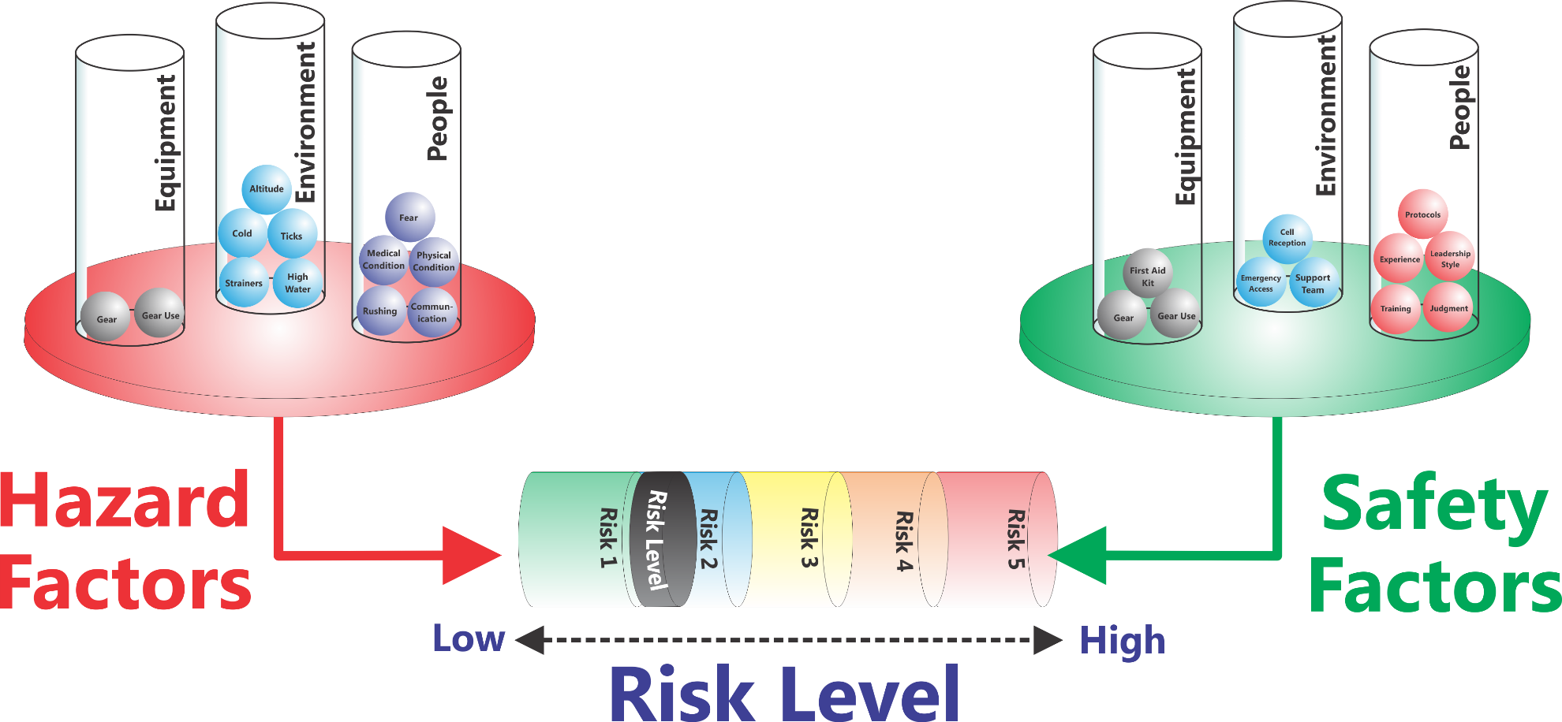
Risk Assessment & Safety Management Model (RASM) ©
Environment
Environment
People
People
Equipment
Equipment
Low
High
Risk Level
Notes:
So now we are back at the overview of the model and I think you have a good sense of the dynamic interaction that this model provides.
Now let’s put it all together. The Hazard Factors operate to push the Risk Level up while the Safety Factors operate to pull the risk level down. For simplicities sake on the illustrations, all the balls are shown as the same size. As we’ve shown some may be much larger than others and ‘weigh more’ having a much greater or lesser influence on the ultimate Risk Level. For example having a hurricane hit your trip is a massive hazard factor made up of a series of conditions (high winds, downed trees, flooding, temperature, etc.)

Slide 39
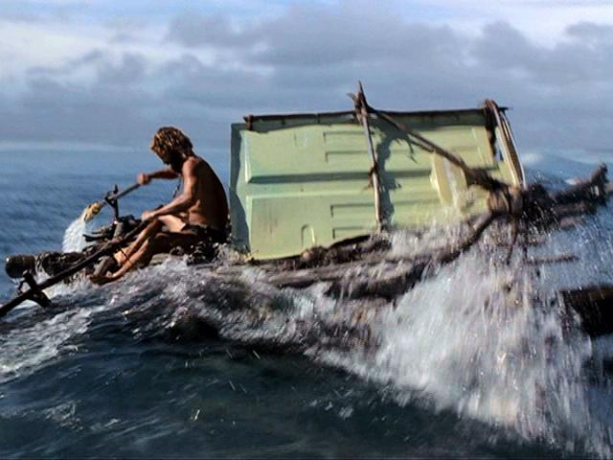
An Accident in the Making - 2
Cast Away Scene 2
DVD Chapter 23
Notes:
Give a summary of what has transpired in the movie up to this point – He survives for 1500 days.
Now watch what happens this time and see what is different from his previous attempt.

Slide 40
Hazard Factors
Equipment
Environment
People
No Food Water
Fear / Anxiety
Paddle
Huge Waves
Indecisive
Raft
Coral Reef
No Plan
Notes:
Explain how he has reduced the Hazard Factors

Slide 41
Safety Factors
Equipment
Environment
People
Sail
Determined
Food Water
Decisive
Paddles
Wind
Plan
Raft
Notes:
Explain how he has increased Safety Factors.
Is his Risk Level 0 – No, but for him, in this situation, it is an Acceptable Level of Risk
Acceptable Risk has to be defined by each program and each individual activity like the R- R+ we discussed before

Slide 42
Risk Assessment & Safety Management Model (RASM) ©
Environment
Environment
People
People
Equipment
Equipment
Low
High
Risk Level
Notes:
So now we are back at the overview of the model and I think you have a good sense of the dynamic interaction that this model provides.
Now let’s put it all together. The Hazard Factors operate to push the Risk Level up while the Safety Factors operate to pull the risk level down. For simplicities sake on the illustrations, all the balls are shown as the same size. As we’ve shown some may be much larger than others and ‘weigh more’ having a much greater or lesser influence on the ultimate Risk Level. For example having a hurricane hit your trip is a massive hazard factor made up of a series of conditions (high winds, downed trees, flooding, temperature, etc.)

Slide 43
Safety Factors – for 100° F/ 38° C
Equipment
Environment
People
Notes:
Explain how he has increased Safety Factors.
Is his Risk Level 0 – No, but for him, in this situation, it is an Acceptable Level of Risk
Acceptable Risk has to be defined by each program and each individual activity like the R- R+ we discussed before

Slide 44
Some Hazards can’t be removed
First Aid Training
People
Allergic Person
People
Benadryl
Equipment
Bees
Environment
Equipment
Epi-
nephrine
Hazard
Factors
Safety
Factors
Low
High
Risk Level
Notes:
I like to reinforce the idea that some hazards can’t be removed and that only by adding Safety Factors in can you reduce the Risk Level. In this example having an environment with bees on the trail and having someone on the trip who is allergic to bees are the things increasing the Risk Level. You can’t remove these things so all you can do is to add Safety Factors on the other side of the equation to reduce the potential severity of the situation if the person gets stung.
Note: Some programs may not carry medications like Benadryl and Epinephrine or allow their staff to use such things. In that case you should come up with your own example that illustrates this point. Or you can refer people back to the Tom Hanks scenario where the waves and the coral reef were still there.

Slide 45
If the Risk Level is still High
Know when to ‘bail out’
  If the Risk Level is too high, what is your expectation of your leaders and their expectation?
Notes:
Ask the class what happens when the Risk Level is high and you cannot bring it down to an acceptable level by reducing Hazard Factors or adding Safety Factors. The answer is to bail out. I give a detailed example from my program where leaders have made a good decision by bailing out. They looked at the situation and determined that there was no way to continue without a significant level of risk.
When you can’t bring the risk down, look at ‘changing the game.’

Slide 46
Transferring this to Campus
Seeing someone who has had too much to drink
Observing someone trying to hook up with someone who is unable to consent
If you see something going wrong and you don’t speak up, what are you?
A Human Factor Hazard Ball!
Being a Leader takes Courage – entering your Brave Space

Slide 47
Diversity & Inclusion Risks
Physical Safety is only one dimension on the Risk Management spectrum
Emotional Safety is equally important and Hazards can be equally life threatening
  Teens committing suicide after bullying
  LGBTQ individuals being harassed
Talk to your staff about where there are Emotional/Interpersonal Hazards, Assess the Risk Level, and establish the necessary guidelines, structures, protocols, culture to manage the risk

Slide 48
7 Steps in RASM
Identify Hazard Factors
Assess Risk Level
Remove Hazard Factors
Assess Risk Level
Add Safety Factors
Assess Risk Level
Bail Out

Slide 49
Risk Assessment & Safety Management Model (RASM) ©
Environment
Environment
People
People
Equipment
Equipment
Low
High
Risk Level
Notes:
So now we are back at the overview of the model and I think you have a good sense of the dynamic interaction that this model provides.
Now let’s put it all together. The Hazard Factors operate to push the Risk Level up while the Safety Factors operate to pull the risk level down. For simplicities sake on the illustrations, all the balls are shown as the same size. As we’ve shown some may be much larger than others and ‘weigh more’ having a much greater or lesser influence on the ultimate Risk Level. For example having a hurricane hit your trip is a massive hazard factor made up of a series of conditions (high winds, downed trees, flooding, temperature, etc.)

Slide 50
Hazing/Sexual Harassment
Men’s Swimming & Diving Season Cancelled
How did this happen? Let’s work backwards:
  What kind of environment existed to allow this behavior?
  What was the culture on the team? How long had it been present?
  Presuming that the coaching staff did not know, what does it say about the level of communication/trust between players & coaches?
  Why didn’t any of the team members tell coaches?

Slide 51
Hazing/Sexual Harassment
What Safety Balls need to be put in place to prevent this from happening again?
  How do we productively build a cohesive team spirit that doesn’t involve tearing down ‘the other’?
  Full Value Contract
  Bystander Intervention Training
  Healthy ‘high challenge’ & healthy activities for team bonding
  Cross team study sessions (match players by courses)
  Swift discipline by coaching staff

Slide 52
Discussion
What is the “typical” Risk Level our program operates at? How much variation is there?
Do our Safety Factors outweigh our Hazard Factors?
How often do we shift into a higher Risk Level on a program?
Are we set up to allow protocols to change as we shift into different Risk Levels?
What do we need to do to implement this system in our organization?
Notes:
These are some important discussion questions to have the group discuss.

Slide 53
Small Group Discussion…
Look at one example of physical risk in your setting and analyze the Hazard Factors, Risk Level and potential Safety Factors
Look at one example of emotional risk in your setting and analyze the Hazard Factors, Risk Level and potential Safety Factors

Slide 54
Implementation: Program Level
Look at each activity you do and assess…
  Hazard Factors in each of these categories…
    Environment
    Equipment
    People
  Safety Factors in each of these categories…
    Environment
    Equipment
    People
  What Risk Level(s) you are comfortable operating with and are appropriate for your program goals?
Notes:
This slide explores how to implement the RASM model in your program. For each activity (backpacking, rock climbing, etc.) you should
Assess the Hazard Factors
Environmental Hazard Factors
Equipment Hazard Factors
People Hazard Factors
Assess your Safety Factors to deal with the potential hazards
Environmental Safety Factors
Equipment Safety Factors
People Safety Factors
Decide if the Risk Level is acceptable
Based on your assessment you need to decide if this activity can be done at an acceptable risk level given your program’s resources.

Slide 55
Implementation: Staff Level
Pre-trip
Assess the Hazard Factors
  Environmental Hazard Factors
  Equipment Hazard Factors
  People Hazard Factors
Prepare an Hazard Briefing for participants
Assess your Safety Factors to deal with the potential hazards
  Environmental Safety Factors
  Equipment Safety Factors
  People Safety Factors
Decide if the Risk Level is acceptable
Notes:
Once you are doing an activity before a trip goes out you need to have field staff run through this same process.
Assess/Review the Hazard Factors
Environmental Hazard Factors
Equipment Hazard Factors
People Hazard Factors
Prepare an Hazard Briefing for participants
What do they need to know to keep themselves safe
Assess/Review your Safety Factors to deal with the potential hazards
Environmental Safety Factors
Equipment Safety Factors
People Safety Factors

Slide 56
Implementation: Staff Level
During the Trip
Teach the RASM Model to Participants
Assess
  Environmental Hazards
  People Hazards
  Equipment
  Increasing Risk Level/Accident Potential
“Treat” all the Hazards you can
Add additional Safety Factors if necessary/possible
Reassess Risk Level
  If it’s still too high, change things
Notes:
During the trip leaders should use the RASM model to regularly assess the situation for Hazard Factors and for increasing Risk Levels. Using a standard medical model you should “treat” (remove) all the Hazard Factors you can and “treat” (add) all the Safety Factors you can and then reassess the situation.
I remind people of the Patient Assessment System (PAS) taught in many first aid courses. This is a model that they probably know already and RASM mirrors this approach. Giving them another tool that syncs with logical frameworks they already use helps them remember.

Slide 57
Implementation: Post Program
After the Trip
Turn in Incident/Near Miss Reports
Review events with staff
Assess need for program changes: protocols, training, resources, etc.
Notes:
Gathering data for both accidents and close calls is essential to get the full picture of potential risk. Remind people about the Accident Iceberg and any examples you gave there.
Using whatever your program’s format is people should turn in both accident reports and close call reports. This is a time to reinforce with leaders how critical this is to overall risk management.
Note: People interested in tools for collecting and managing incident data should refer to the International Incident Database Project (www.incidentdatabase.org)

Slide 58
Analyzing an Accident
Reviewing existing accidents or near misses in your program using the model is a useful technique to assess your program
Analyze an Accident in small groups:
  Call out some accidents/close calls you have seen in your program or others:
    Aquatics
    Climbing Wall
    Field Sport (Rugby)
    Heat
    Ice Hockey

Slide 59
Implementing RASM
Look at each activity you do and assess…
  Hazard Factors in each of these categories…
    Environment
    Equipment
    People
  Safety Factors in each of these categories…
    Environment
    Equipment
    People
  What Risk Level(s) you are comfortable operating with and are appropriate for your program goals?
Notes:
This slide explores how to implement the RASM model in your program. For each activity (backpacking, rock climbing, etc.) you should
Assess the Hazard Factors
Environmental Hazard Factors
Equipment Hazard Factors
People Hazard Factors
Assess your Safety Factors to deal with the potential hazards
Environmental Safety Factors
Equipment Safety Factors
People Safety Factors
Decide if the Risk Level is acceptable
Based on your assessment you need to decide if this activity can be done at an acceptable risk level given your program’s resources.

Slide 60
Take Home Action Steps
For each program activity brainstorm a list of Hazard Factors in each of the three major categories (Environment, Equipment, People)
For each program activity brainstorm a list of Safety Factors in each of the three major categories (Environment, Equipment, People) designed to mitigate against Hazard Factors

Slide 61
Take Home Action Steps
Balance the Hazard Factors against the Safety Factors and determine the range of Risk Levels you will be operating in. Based on your program, decide whether the Risk Level is acceptable or not.
If the Risk Level is not acceptable, assess how to modify Hazard Factors and Safety Factors to reduce the Risk Level.
Have your students think about how this model applies to their lives back on campus – for example seeing someone who is severely intoxicated
Notes:
If you see something, say something. This is Bystander Intervention back on campus. If you see something that is a potential hazardous situation and you don’t intervene, what are you? You are a Hazard Ball (People Hazard). I remind my students that others know that they are outdoor program leaders and know first aid and CPR. If they see you not reacting, they may assume that it’s not a hazardous situation. Leadership is about stepping up even when it’s difficult.

Slide 62
Final Thoughts
Final Thoughts
The biggest mistake
about a mistake
is not learning from it

Slide 63
Resources
www.OutdoorEd.com
Search for NIRSA or RASM
Copyright © 2019 Rick Curtis, Outdoor Ed LLC. All rights reserved.

Slide 64
Learn how to Track Incidents & Close Calls with our Cloud-based Solutions
www.IncidentAnalytix.com
Copyright © 2019 Rick Curtis, Outdoor Ed LLC. All rights reserved.

Slide 65
Sample Case Studies to Analyze

Slide 66
Spinning Class Scenario
Rhabdomyolysis
  Freebie Rhabdomyolysis: A Public Health Concern. Spin Class-Induced Rhabdomyolysis
    https://www.amjmed.com/article/S0002-9343(16)31206-2/fulltext
  Risk factors for the development of rhabdomyolysis are related to the intensity of the exercise, the conditioning of the participant, hydration, and body temperature, in addition to other potential contributing factors. Physiology studies have demonstrated that significant numbers of calories are burned,⁵ fluid losses are significant,⁶ and body temperatures increase⁷ during spinning classes.
1 Freebie Rhabdomyolysis: A Public Health Concern. Spin Class-Induced Rhabdomyolysis, Brogan, Maureen et al.
The American Journal of Medicine , Volume 130 , Issue 4 , 484 - 487

Slide 67
Hazard Factors
Equipment
Environment
People
Lack of Water
Hot Room
Dark Space
Loud Music
Large Class Size
Inexperienced Participant
‘Go for it’ attitude
Poor physical shape
Post exams
Inexperienced Instructor
Notes:
Explain how he has reduced the Hazard Factors

Slide 68
Is this a Preventable Accident?
Clinical Significance¹
  Spinning is an intense exercise.
  Spinning can put newcomers at risk for exertional rhabdomyolysis.
  Guidelines for the public need to be established that include safe ways to start spinning.
  There needs to be public awareness of signs and symptoms of rhabdomyolysis so that early treatment can be obtained.
1 Freebie Rhabdomyolysis: A Public Health Concern. Spin Class-Induced Rhabdomyolysis, Brogan, Maureen et al.
The American Journal of Medicine , Volume 130 , Issue 4 , 484 - 487

Slide 69
Backpacking Trip Scenario
Sally is leading a group of ninth graders on the school’s annual 4-day wilderness trip. This is Sally’s fourth such trip. Dan the other teacher from the school is new this year and doesn’t have any backpacking experience. But it’s hard to find teachers at the school who are willing to go. Dan is young and a good athlete and seems to be learning quickly. It’s early September in the Shenandoahs and the group of 8 students and two teachers has started their second day of hiking. The temperature has soared up to the nineties with humidity around 80%. The group slept in and cooked pancakes so they got a late start on the trail. After a 2 mile hike, the group stops for lunch. Sally notices large cumulus clouds starting to build over the ridge. It’s already after one o’clock and eager to get on to camp, they finish lunch and head off for a long descent down Little Devil’s Staircase, a ledgy section of rock trail along a dry stream gorge.

Slide 70
Backpacking Trip Scenario
The upper section is dry and the rock is slick and polished. As the afternoon progresses, the group is moving more slowly down the gorge. The smaller students are having trouble handling the steep sections and slick rocks with their packs. More than once Dan has had to take a student’s pack as well as his own over the difficult sections. The clouds have now become thick thunderheads and the sky is darkening. They still haven’t reached the bottom trail. The wind is picking up and large raindrops are spattering here and there on the rocks. Suddenly the sky opens up and the rain is falling in torrents. Dan, while carrying a student’s pack, slips on the wet polished rock and falls backwards striking his head sharply against a boulder. The student next to Dan screams. Sally is at the front, picking her way down the trail when she hears the scream. She drops her pack and scrambles up to Dan who is unresponsive when she first arrives. She quickly checks for breathing and pulse and then Dan starts to open his eyes.

Slide 71
Backpacking Trip Scenario
Analyze Hazard Factors
  Environmental Hazards
  People Hazards
  Equipment Hazards
Recommend Safety Factors
  Environmental Hazards
  People Hazards
  Equipment Hazards

Slide 72
Backpacking Trip Analysis
Environmental Hazards
  Rocky trail
  Wet trail
  Rain
  Lightning
  Heat
  Humidity
  Dehydration
People Hazards
  Age of participants - their physical abilities and experience
  Dan’s inexperience
  Limited group resources in an emergency
Equipment Hazards
  Too much weight in packs

Slide 73
Backpacking Trip Analysis
Reducing the Risk Level
  Environmental Safety
    The trip route should include an understand of how weather conditions can increase the Risk Level of a particular section.
    The group should have a plan for "bail out" in case of bad weather.
  People Safety
    More experienced leaders.
    The group can have a better plan for the day in terms of mileage, when to leave camp, rest breaks, lunch breaks, etc.
    The leaders should have better knowledge of the appropriateness of the route to the age group/experience of the participants.
    Have more group resources in the event an emergency (other adult chaperones)
    Have a protocol for dealing with storms
  Equipment Safety
    Better packs for the size of the kids
    Less weight

